Slide 1
UNIT-IV
Intermediate Code Generation
Compiler Design- Unit-4
Notes:
‹#›

Slide 2
Contents
Intermediate Code Generation
Intermediate Languages - prefix - postfix
Quadruple - triple - indirect triples Representation
Syntax tree- Evaluation of expression - three-address code
Synthesized attributes – Inherited attributes
Intermediate languages – Declarations
Assignment Statements
Boolean Expressions, Case Statements
Back patching – Procedure calls
Code Generation
Issues in the design of code generator
The target machine – Runtime Storage management
A simple Code generator
Code Generation Algorithm
Register and Address Descriptors
Generating Code of Assignment Statements
Cross Compiler – T diagrams
Issues in Cross compilers

Slide 3
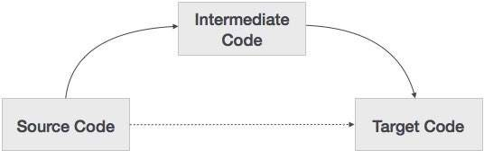
What is intermediate code?
During the translation of a source program into the object code for a target machine, a compiler may generate a middle-level language code, which is known as intermediate code

Slide 4
Intermediate code
The following are commonly used intermediate code representation :
Syntax tree
Postfix Notation
Three-Address Code

Slide 5
Syntax tree
Syntax tree is more than condensed form of a parse tree.
The operator and keyword nodes of the parse tree are moved to their parents and a chain of single productions is replaced by single link in syntax tree.
The internal nodes are operators and child nodes are operands.
To form syntax tree put parentheses in the expression, this way it's easy to recognize which operand should come first.

Slide 6
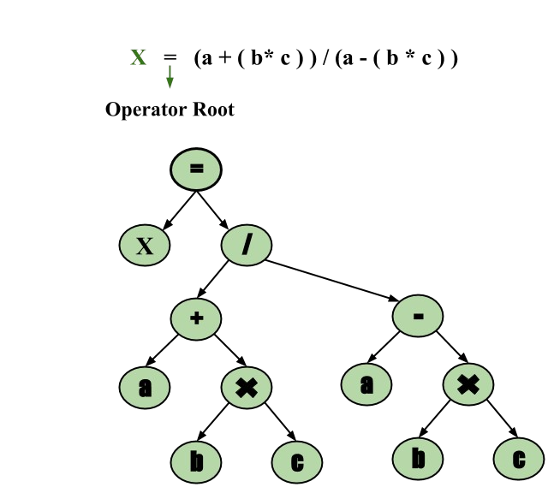
Syntax tree
Example –
x = (a + b * c) / (a – b * c)

Slide 7
Postfix Notation
The ordinary (infix) way of writing the sum of a and b is with operator in the middle : a + b
The postfix notation for the same expression places the operator at the right end as ab +.
In general, if e1 and e2 are any postfix expressions, and + is any binary operator, the result of applying + to the values denoted by e1 and e2 is postfix notation by e1e2 +.
No parentheses are needed in postfix notation because the position and arity (number of arguments) of the operators permit only one way to decode a postfix expression.
In postfix notation the operator follows the operand.

Slide 8
Postfix Notation
Example – The postfix representation of the expression
(a – b) * (c + d) + (a – b) is
ab – cd + ab -+*.

Slide 9
Three-Address Code
A statement involving no more than three references(two for operands and one for result) is known as three address statement.
A sequence of three address statements is known as three address code. Three address statement is of the form x = y op z , here x, y, z will have address (memory location).
Sometimes a statement might contain less than three references but it is still called three address statement.
For Example :a = b + c * d;
The intermediate code generator will try to divide this expression into sub-expressions and then generate the corresponding code.
r1 = c * d;
r2 = b + r1;
a = r2

Slide 10
Three-Address Code
A three-address code has at most three address locations to calculate the expression. A three- address code can be represented in three forms :
Quadruples
Triples
Indirect Triples

Slide 11
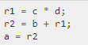
Quadruples
Each instruction in quadruples presentation is divided into four fields: operator, arg1, arg2, and result. The example is represented below in quadruples format:
OP | arg1 | arg2 | result
* | c | d | r1
+ | b | r1 | r2
= | r2 |  | a

Slide 12
Triples
Each instruction in triples presentation has three fields : op, arg1, and arg2.The results of respective sub-expressions are denoted by the position of expression.
 | OP | arg1 | arg2
(0) | * | c | d
(1) | + | b | (0)
(2) | = | (1)

Slide 13
Indirect Triples
This representation is an enhancement over triples representation.
It uses pointers instead of position to store results.
This enables the optimizers to freely re-position the sub-expression to produce an optimized code.
 |  | OP | arg1 | arg2
35 | (0) | * | c | d
36 | (1) | + | b | (0)
37 | (2) | = | (1)

Slide 14
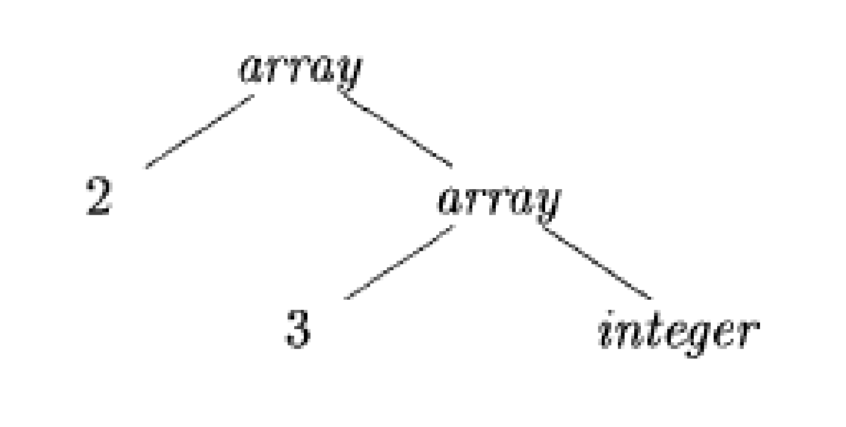
Type Expressions
Example: int[2][3]
array(2,array(3,integer))
A basic type is a type expression
A type name is a type expression
A type expression can be formed by applying the array type constructor to a number and a type expression.
A record is a data structure with named field
A type expression can be formed by using the type constructor → for function types
If s and t are type expressions, then their Cartesian product s*t is a type expression
Type expressions may contain variables whose values are type expressions

Slide 15
Type Equivalence
They are the same basic type.
They are formed by applying the same constructor to structurally equivalent types.
One is a type name that denotes the other.

Slide 16
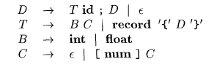
Declarations

Slide 17
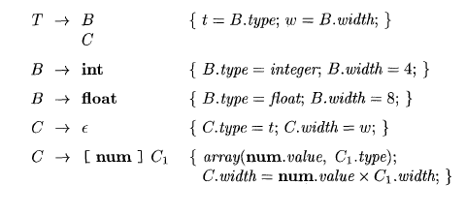
Storage Layout for Local Names
Computing types and their widths

Slide 18
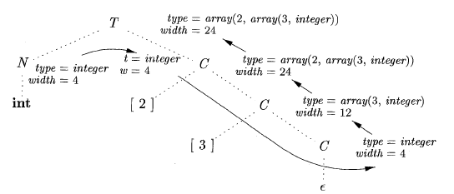
Storage Layout for Local Names
Syntax-directed translation of array types

Slide 19
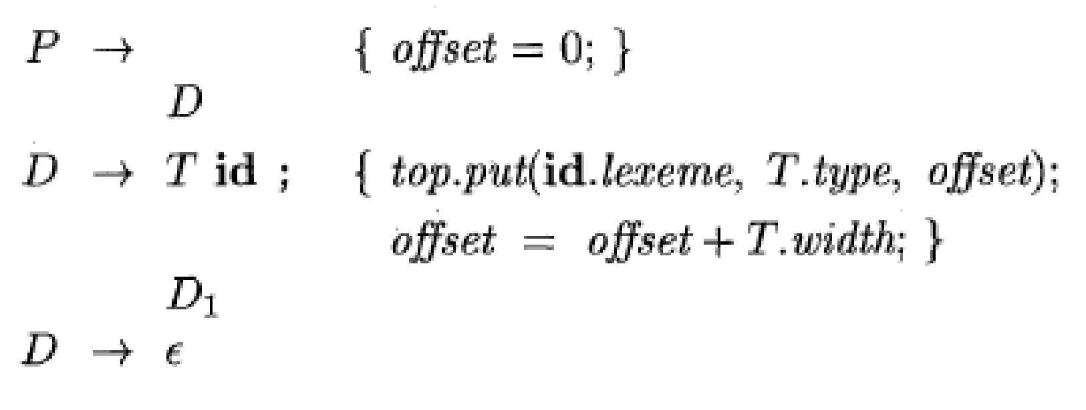
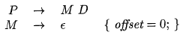
Sequences of Declarations
Actions at the end:

Slide 20
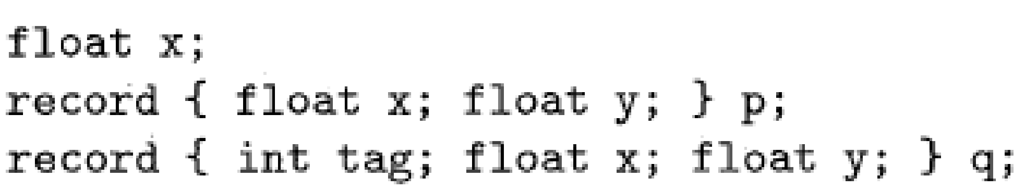
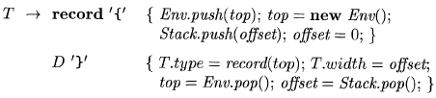
Fields in Records and Classes

Slide 21
Translation of Expressions and Statements
We discussed how to find the types and offset of variables
We have therefore necessary preparations to discuss about translation to intermediate code
We also discuss the type checking

Slide 22
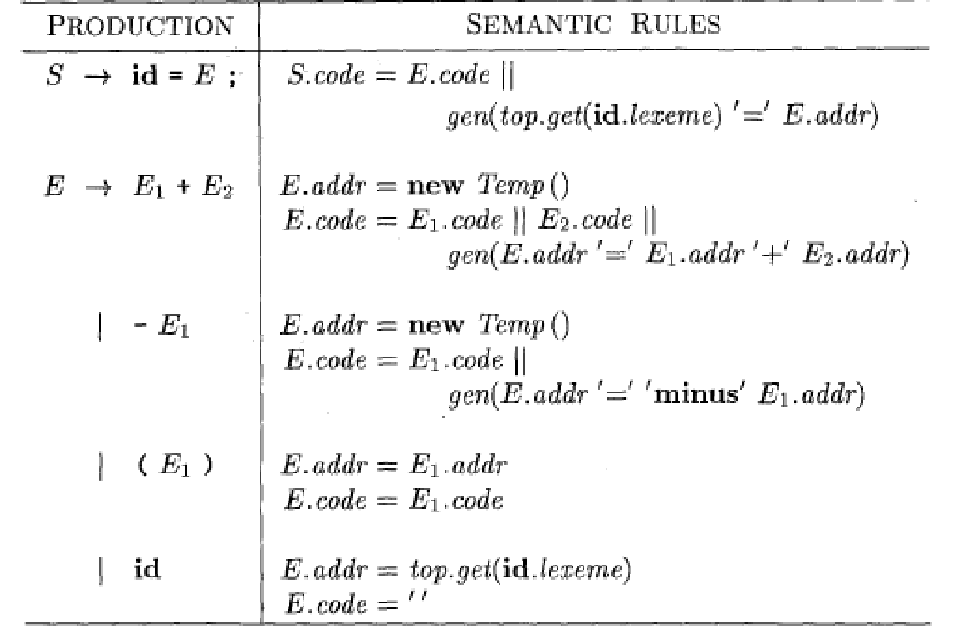
Three-address code for expressions

Slide 23
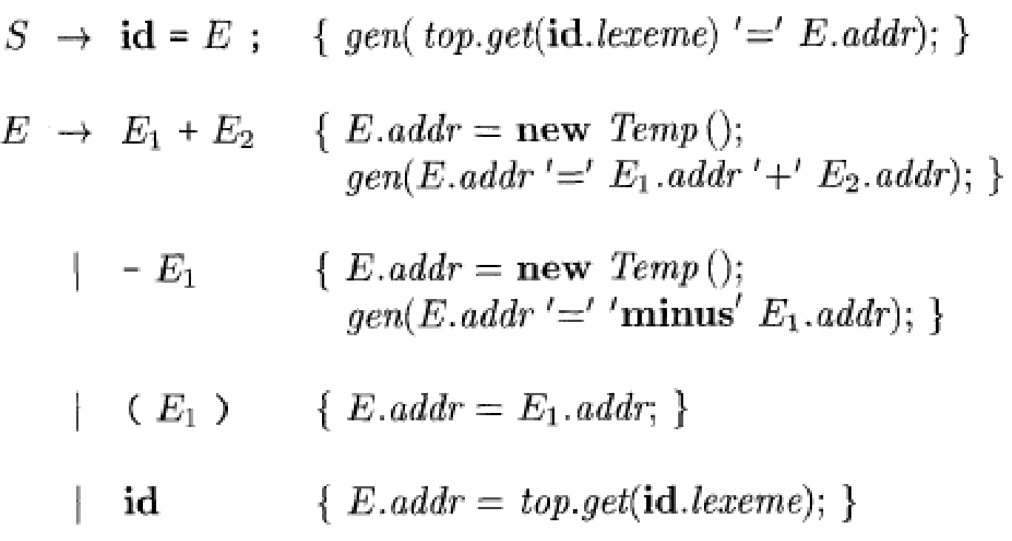
Incremental Translation

Slide 24
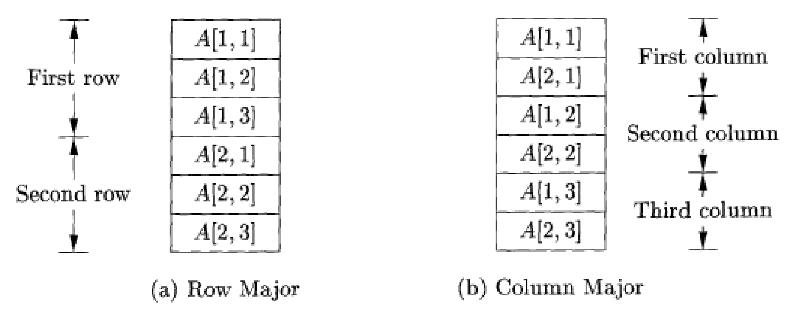
Addressing Array Elements
Layouts for a two-dimensional array:

Slide 25
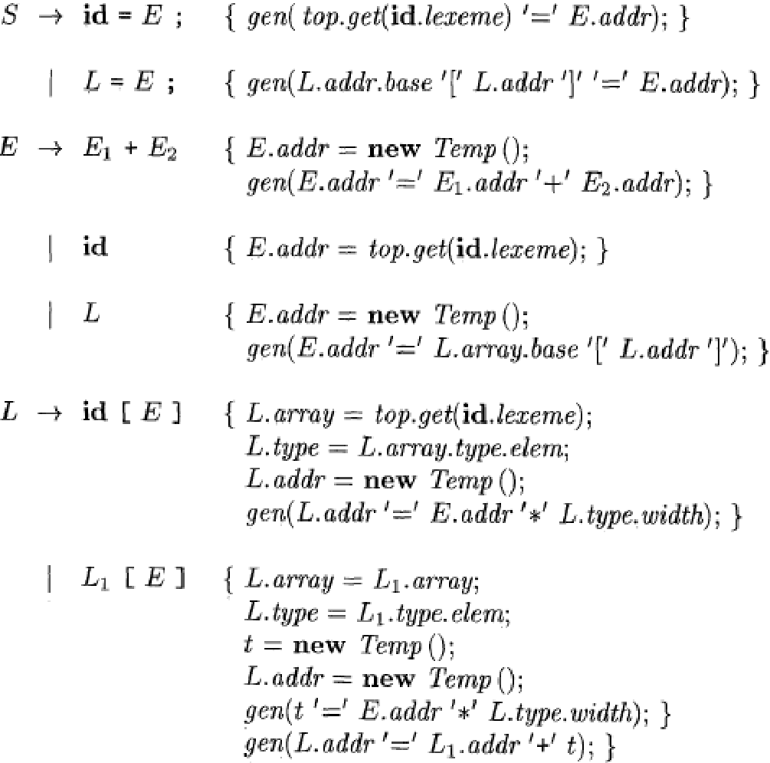
Semantic actions for array reference

Slide 26
Translation of Array References
Nonterminal L has three synthesized attributes:
L.addr
L.array
L.type

Slide 27
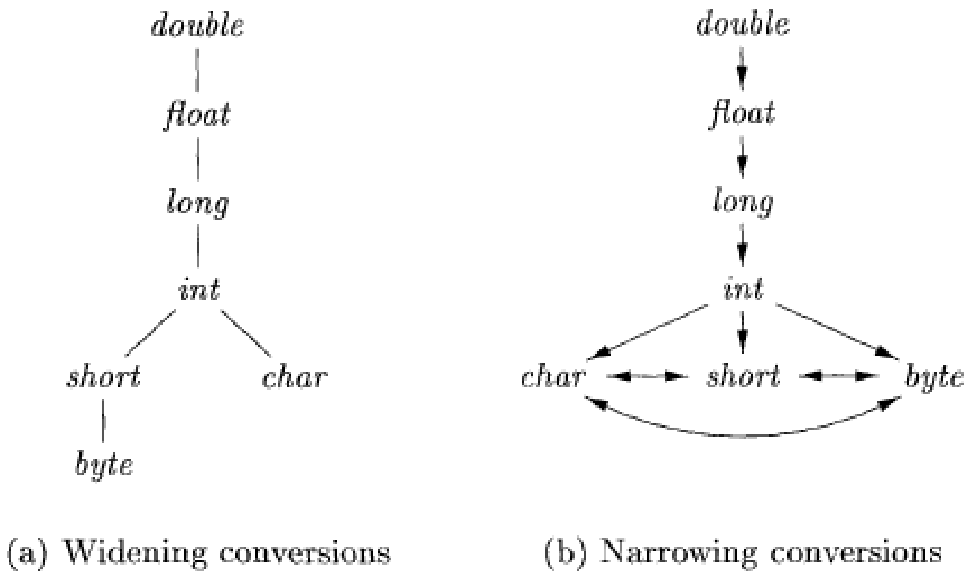
Conversions between primitive types in Java

Slide 28
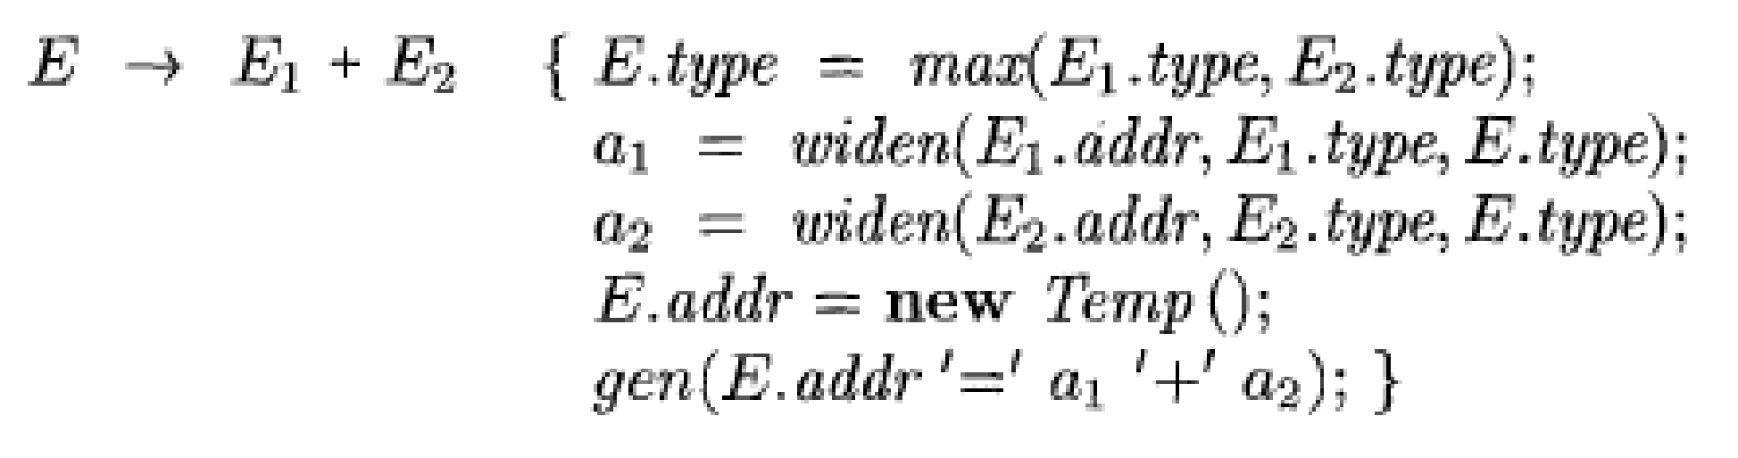
Introducing type conversions into expression evaluation

Slide 29
• Syntax Directed Translations
^{• Syntax Directed Definitions}
• Implementing Syntax Directed Definitions
– Dependency Graphs
– S-Attributed Definitions
– L-Attributed Definitions
^{• Translation Schemes}

Slide 30
(3)
Semantic Analysis
•
Semantic Analysis computes additional information related to the
of the program once the syntactic structure is known.
^{meaning}
•
In typed languages as C, semantic analysis involves adding information to
the symbol table and performing type checking.
•
The information to be computed is beyond the capabilities of standard
parsing techniques, therefore it is not regarded as syntax.
•
As for Lexical and Syntax analysis, also for Semantic Analysis we need both
a Representation Formalism and an Implementation Mechanism.
•
As representation formalism this lecture illustrates what are called Syntax
Directed Translations.

Slide 31
(4)
Syntax Directed Translation: Intro
• The Principle of Syntax Directed Translation states that the meaning
input sentence is related to its syntactic structure, i.e., to its Parse-Tree.
^{of an}
• By Syntax Directed Translations we indicate those formalisms for specify-
ing translations for programming language constructs guided by context-free
grammars.
– We associate Attributes to the grammar symbols representing the
language constructs.
– Values for attributes are computed by Semantic Rules associated with grammar productions.

Slide 32
(5)
Syntax Directed Translation:
Intro
(Cont.)
• Evaluation of Semantic Rules may:
– Generate Code;
– Insert information into the Symbol Table;
– Perform Semantic Check;
– Issue error messages;
– etc.
• There are two notations for attaching semantic
1. Syntax Directed Definitions. High-level
^{rules:}
specification hiding
^{many}
implementation details (also called Attribute Grammars).
2. Translation Schemes. More implementation oriented: Indicate in which semantic rules are to be evaluated.
^{the order}

Slide 33
(6)
Summary
• Syntax Directed Translations
^{• Syntax Directed Definitions}
• Implementing Syntax Directed Definitions
– Dependency Graphs
– S-Attributed Definitions
– L-Attributed Definitions
^{• Translation Schemes}

Slide 34
(7)
Syntax Directed Definitions
• Syntax Directed Definitions are a generalization of context-free grammars
in which:
1. Grammar symbols have an associated set of Attributes;
2. Productions are associated with Semantic Rules for computing the values of attributes.
• Such formalism generates Annotated Parse-Trees where each node of the
tree is a record with a field for each attribute (e.g., X.a indicates the attribute
a of the grammar symbol X ).

Slide 35
(8)
Syntax Directed Definitions (Cont.)
• The value of an attribute of a grammar symbol at a given parse-tree
^{node is}
defined by a semantic rule associated with the production used at that node.
• We distinguish between two kinds of attributes:
1. Synthesized Attributes. They are computed from the values of the
attributes of the children nodes.
2. Inherited Attributes. They are computed from the values of the attributes of both the siblings and the parent nodes.

Slide 36
(9)
Form of Syntax Directed Definitions
• Each production, A → α, is associated with a set of semantic rules:
b := f (c₁ , c₂ , . . . , c_{k} ), where f is a function and either
1. b is a synthesized attribute of A, and c₁ , c₂ , . . . , c_{k} are attributes of the
grammar symbols of the production, or
2. b is an inherited attribute of a grammar symbol in α,
^{and c}₁ ^{, c}₂ ^{, . . . , c}_{k}
are attributes of grammar symbols in α or attributes of A.
• Note. Terminal symbols are assumed to have synthesized attributes supplied
by the lexical analyzer.
• Procedure calls (e.g. print in the next slide) define values of Dummy
synthesized attributes of the non terminal on the left-hand side of the production.

Slide 37

(10)
Syntax Directed Definitions: An Example
• Example. Let us consider the Grammar for arithmetic expressions.
^{The}
Syntax Directed Definition associates to each non terminal a synthesized
^{attribute}
called val.
PRO D U C T ION
^{SE M A N T I C RU L E}
print(E.val)
L
E
E
T
T
F
F
^{→ En}
→
→
→
→
→
→
^{E}₁
T
T₁
F
+ T
E.val
E.val
T .val
T .val
F.val
F.val
^{:= E}₁^{.val}
:= T .val
+ T .val
∗
F
^{:= T}₁ ^{.val ∗ F.val}
:= F.val
:= E.val
:=digit.lexval
(E)
digit

Slide 38
S-Attributed Definitions
Definition. An S-Attributed Definition is a Syntax Directed Definition that uses
only synthesized attributes.
• Evaluation Order. Semantic rules in a S-Attributed Definition can be
evaluated by a bottom-up, or PostOrder, traversal of the parse-tree.
• Example. The above arithmetic grammar is an example of an S-Attributed
(11)
^{Definition.}
^{The}
^{annotated parse-tree for the}
L
input 3*5+4n is:
E.val =
+
¹⁹
n
E.val
⁼
¹⁵
T .val = 4
T .val
⁼
¹⁵
F.val = 4
digit.lexval= 4
T .val
⁼ ³
*
F.val
⁼ ⁵
F.val
⁼ ³
digit.lexval= 5
digit.lexval= 3

Slide 39
(12)
Inherited Attributes
• Inherited Attributes are useful for expressing the dependence of a
on the context in which it appears.
^{construct}
• It is always possible to rewrite a syntax directed definition to use only
synthesized attributes, but it is often more natural to use both synthesized and inherited attributes.
• Evaluation Order. Inherited attributes cannot be evaluated by a simple
PreOrder traversal of the parse-tree:
– Unlike synthesized attributes, the order in which the inherited attributes
of the children are computed is important!!! Indeed:
∗ Inherited attributes of the children can depend from both left and right
siblings!

Slide 40
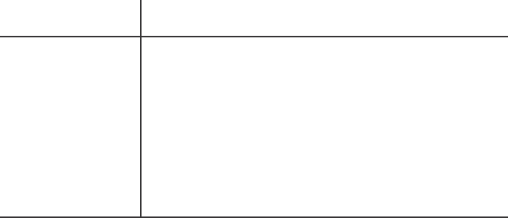
Inherited Attributes: An Example
(13)
• Example. Let us consider the syntax directed definition with both inherited
^{and}
synthesized attributes for the grammar for
^{“type}
^{declarations”:}
^{PRO D U C T I ON}
D → T L
^{SE M A N T I C RU L E}
L.in := T .type
T .type :=integer
T .type :=real
L₁ .in := L.in; addtype(id.entry, L.in)
addtype(id.entry, L.in)
a synthesized attribute, type, determined by the
T
T
L
L
^{→int}
→real
→ L₁ , id
→ id
^{• The}
non terminal T has
^{keyword in the declaration.}
• The production D → T L is associated with the semantic rule L.in :=
T .type which set the inherited attribute L.in.
^{• Note: The production L → L}₁ , id distinguishes the two occurrences of L.

Slide 41
Inherited Attributes: An Example (Cont.)
(14)
• Synthesized attributes can be evaluated by a PostOrder traversal.
• Inherited attributes that do not depend from right children can be evaluated by a classical PreOrder traversal.
• The annotated parse-tree for the input real id₁ ^{, id}₂,
D
T .type = real
^{id}₃
^{is:}
L.in
real
L.in
,
^{id}₃
L.in
,
^{id}₂
^{id}₁

Slide 42
Inherited Attributes: An Example (Cont.)
(14)
• Synthesized attributes can be evaluated by a PostOrder traversal.
• Inherited attributes that do not depend from right children can be evaluated
by a classical PreOrder traversal.
• The annotated parse-tree for the input real id₁ , id₂, id₃ is:
D
T .type = real
L.in= real
,
real
L.in
^{id}₃
L.in
,
^{id}₂
^{id}₁

Slide 43
Inherited Attributes: An Example (Cont.)
(14)
• Synthesized attributes can be evaluated by a PostOrder traversal.
• Inherited attributes that do not depend from right children can be evaluated
by a classical PreOrder traversal.
• The annotated parse-tree for the input real id₁ , id₂, id₃ is:
D
T .type = real
L.in= real
,
real
L.in=
,
^{real}
^{id}₃
L.in
^{id}₂
^{id}₁

Slide 44
Inherited Attributes: An Example (Cont.)
(14)
• Synthesized attributes can be evaluated by a PostOrder traversal.
• Inherited attributes that do not depend from right children can be evaluated
by a classical PreOrder traversal.
• The annotated parse-tree for the input real id₁ , id₂, id₃ is:
D
T .type = real
L.in= real
,
real
L.in=
^{real}
^{id}₃
L.in= real
^{id}₁
,
^{id}₂
• L.in is then inherited top-down the tree
by the other L-nodes.
• At each L-node the procedure addtype inserts into the symbol table the type
of the identifier.

Slide 45
(15)
Summary
• Syntax Directed Translations
^{• Syntax Directed Definitions}
• Implementing Syntax Directed Definitions
– Dependency Graphs
– S-Attributed Definitions
– L-Attributed Definitions
^{• Translation Schemes}

Slide 46
(16)
Dependency Graphs
• Implementing a Syntax Directed Definition consists primarily in finding an
order for the evaluation of attributes
– Each attribute value must be available when a computation is performed.
• Dependency Graphs are the most general technique used to evaluate syntax
directed definitions with both synthesized and inherited attributes.
• A Dependency Graph shows the interdependencies among the attributes of
the various nodes of a parse-tree.
– There is a node for each attribute;
– If attribute b depends on an attribute c there is a link from the node for c
to the node for b (b ← c).
• Dependency Rule: If an attribute b depends from an attribute c, then we need to fire the semantic rule for c first and then the semantic rule for b.

Slide 47
(17)
Evaluation Order
• The evaluation order of semantic rules depends from a Topological
derived from the dependency graph.
Sort
• Topological Sort: Any ordering m₁^{, m}₂^{, . . . , m}_{k} ^{such that if m}_{i} ^{→ m}_{j}
is a link in the dependency graph then m_{i} < m_{j} .
• Any topological sort of a dependency graph gives a valid order to evaluate the semantic rules.

Slide 48

(18)
Dependency Graphs: An Example
• Example. Build the dependency graph for the parse-tree of real id₁^{, id}₂ ,
^{id}₃ .

Slide 49
(19)
Implementing Attribute Evaluation: General Remarks
• Attributes can be evaluated by building a dependency graph at compile-time
and then finding a topological sort.
^{• Disavantages}
1. This method fails if the dependency graph has a cycle: We need a test for
non-circularity;
2. This method is time consuming due to the construction of the dependency graph.
• Alternative Approach. Design the syntax directed definition in such a
way that attributes can be evaluated with a fixed order avoiding to build the dependency graph (method followed by many compilers).

Slide 50
(20)
Strongly Non-Circular Syntax Directed Definitions
• Strongly Non-Circular Syntax Directed Definitions. Formalisms
^{for}
which an attribute evaluation order can be fixed at compiler construction
time.
– They form a class that is less general than the class of non-circular
definitions.
– In the following we illustrate two kinds of strictly non-circular definitions:
S-Attributed and L-Attributed Definitions.

Slide 51
(21)
Summary
• Syntax Directed Translations
^{• Syntax Directed Definitions}
• Implementing Syntax Directed Definitions
– Dependency Graphs
– S-Attributed Definitions
– L-Attributed Definitions
^{• Translation Schemes}

Slide 52
(22)
Evaluation of S-Attributed Definitions
• Synthesized Attributes can be evaluated by a bottom-up parser
as the
input is being analyzed avoiding the construction of a dependency graph.
• The parser keeps the values of the synthesized attributes in its stack.
• Whenever a reduction A → α is made, the attribute for A is computed from
the attributes of α which appear on the stack.
• Thus, a translator for an S-Attributed Definition can be simply implemented
by extending the stack of an LR-Parser.

Slide 53


Extending a Parser Stack
(23)
• Extra fields are added to the stack to hold the values of synthesized attributes.
• In the simple case of just one attribute per grammar symbol the stack has two fields: state and val
state
val
Z
Y
X
. . .
Z.x
Y .x
X.x
. . .
• The current top of the stack is indicated by the pointer top.
• Synthesized attributes are computed just before each reduction:
– Before the reduction A → X Y Z is made, the attribute for A is computed: A.a := f (val[top], val[top − 1], val[top − 2]).

Slide 54

Extending a Parser Stack: An Example
• Example. Consider the S-attributed definitions for the arithmetic
(24)
^{expres-}
^{sions.}
To evaluate attributes the parser executes the
^{following code}
^{PRO D U C T I ON}
^{CO D E}
print(val[top − 1])
L
E
E
T
T
F
F
^{→ En}
→
→
→
→
→
→
^{E}₁
T
+ T
val[ntop]
^{:=}
val[top]
^{+ val[top − 2]}
^{T}₁ ^{∗ F}
F
(E)
digit
val[ntop]
^{:=}
val[top]
^{∗ val[top − 2]}
val[ntop]
^{:=}
^{val[top − 1]}
^{• The variable ntop is set}
top is set to ntop: When
ntop = top − r + 1.
to the new top of the stack. After a reduction is done
a reduction A → α is done with |α| = r, then
• During a shift action both the token and its value are pushed into the stack.

Slide 55
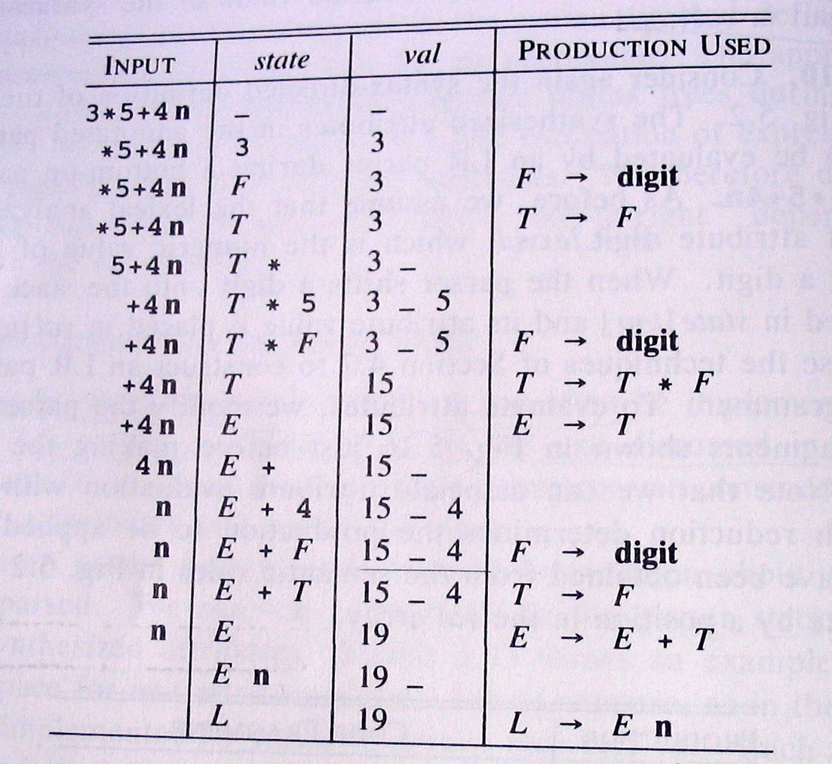
Extending a Parser Stack: An Example (Cont.)
(25)
• The following Figure shows the moves made by the parser on input 3*5+4n.
– Stack states are replaced by their corresponding grammar symbol;
– Instead of the token digit the actual value is shown.

Slide 56
(26)
Summary
• Syntax Directed Translations
^{• Syntax Directed Definitions}
• Implementing Syntax Directed Definitions
– Dependency Graphs
– S-Attributed Definitions
– L-Attributed Definitions
^{• Translation Schemes}

Slide 57
(27)
L-Attributed Definitions
• L-Attributed Definitions contain both synthesized and inherited attributes
but do not need to build a dependency graph to evaluate them.
• Definition. A syntax directed definition is L-Attributed if each inherited
attribute of X_{j} in a production A → X₁ . . . X_{j} . . . X_{n}, depends only on:
1. The attributes of the symbols to the left (this is what L in L-Attributed
^{stands for) of X}_{j} ^{, i.e., X}₁^{X}₂ . . .
2. The inherited attributes of A.
^{X}_{j −1},
^{and}
• Theorem. Inherited attributes in L-Attributed Definitions can be computed
by a PreOrder traversal of the parse-tree.

Slide 58
Evaluating L-Attributed Definitions
(28)
• L-Attributed Definitions are a class of syntax directed definitions whose
attributes can always be evaluated by single traversal of the parse-tree.
• The following procedure evaluate L-Attributed Definitions by mixing
PostOrder (synthesized) and PreOrder (inherited) traversal.
Algorithm: L-Eval(n: Node)
Input: Node of an annotated parse-tree.
Output: Attribute evaluation.
Begin
For each child m of n, from left-to-right
Begin
Evaluate inherited attributes of m;
L-Eval(m)
End;
Evaluate synthesized attributes of n
Do
End.

Slide 59
(29)
Summary
• Syntax Directed Translations
^{• Syntax Directed Definitions}
• Implementing Syntax Directed Definitions
– Dependency Graphs
– S-Attributed Definitions
– L-Attributed Definitions
^{• Translation Schemes}

Slide 60
(30)
Translation Schemes
• Translation Schemes are more implementation oriented than syntax directed
definitions since they indicate the order in which semantic rules and attributes are to be evaluated.
• Definition. A Translation Scheme is a context-free grammar in which
1. Attributes are associated with grammar symbols;
2. Semantic Actions are enclosed between braces {} and are inserted within the right-hand side of productions.
• Yacc uses Translation Schemes.

Slide 61
(31)
Translation Schemes (Cont.)
• Translation Schemes deal with both synthesized and inherited attributes.
• Semantic Actions are treated as terminal symbols: Annotated parse-trees
contain semantic actions as children of the node standing for the correspond- ing production.
• Translation Schemes are useful to evaluate L-Attributed definitions at parsing
time (even if they are a general mechanism).
– An L-Attributed Syntax-Directed Definition can be turned into a
Translation Scheme.

Slide 62
(32)
Translation Schemes: An Example
• Consider the Translation Scheme for the L-Attributed Definition for
declarations”:
^{“type}
^{D →}
^{T {L.in := T .type} L}
int {T .type :=integer}
real {T .type :=real}
{L₁ .in := L.in} L₁ , id {addtype(id.entry, L.in)}
id {addtype(id.entry, L.in)}
T
T
L
L
→
→
→
→

Slide 63
(33)
Translation Schemes: An Example (Cont.)
• Example (Cont). The parse-tree with semantic actions for the input
real id₁, id₂, id₃ is:
D
T
^{{L.in := T .type}}
L
real
^{{T.type}
^{:= real} {L}₁ ^{.in := L.in}}
^{L}₁
,
^{id}₃
^{{addtype(id}₃ ^{.entry,}
^{L.in)}}
^{{L}₂ ^{.in := L}₁ ^{.in} L}₂
,
^{id}₂ ^{{addtype(id}₂ ^{.entry,}
^{L}₁ ^{.in)}}
^{id}₁
^{{addtype(id}₁ ^{.entry, L}₂ ^{.in)}}
• Traversing the Parse-Tree in depth-first order (PostOrder) we can
evaluate the attributes.

Slide 64
(34)
Design of Translation Schemes
• When designing a Translation Scheme we must be sure that an attribute
is available when a semantic action is executed.
^{value}
• When the semantic action involves only synthesized attributes: The
action can be put at the end of the production.
– Example. The following Production and Semantic Rule:
^{T → T}₁ ^{∗ F}
T .val
^{:= T}₁ ^{.val}
^{∗ F.val}
^{yield the translation scheme:}
^{T → T}₁ ^{∗ F}
^{{T .val := T}₁ ^{.val ∗ F.val}}

Slide 65
(35)
Design of Translation Schemes (Cont.)
• Rules for Implementing L-Attributed SDD’s. If we have an L-Attibuted
Syntax-Directed Definition we must enforce the following restrictions:
1. An inherited attribute for a symbol in the right-hand side of a production
must be computed in an action before the symbol;
2. A synthesized attribute for the non terminal on the left-hand side can only be computed when all the attributes it references have been computed: The action is usually put at the end of the production.

Slide 66
(36)
Compile-Time Evaluation of Translation Schemes
• Attributes in a Translation Scheme following the above rules can be computed
at compile time similarly to the evaluation of S-Attributed Definitions.
• Main Idea. Starting from a Translation Scheme (with embedded actions) we
introduce a transformation that makes all the actions occur at the right ends
of their productions.
– For each embedded semantic action we introduce a new Marker (i.e., a
non terminal, say M ) with an empty production (M → ǫ);
– The semantic action is attached at the end of the production M → ǫ.

Slide 67
(37)
Compile-Time Evaluation of Translation Schemes
(Cont.)
• Example. Consider the following translation scheme:
S
S C
^{→ aA{C.i = f (A.s)}C}
→ bAB{C.i = f (A.s)}C
→ c{C.s = g(C.i)}
^{Then, we add new markers M}₁ ^{, M}₂
^{with:}
S
S
^{→ aAM}₁ ^{C}
^{→ bABM}₂ ^{C}
^{M}₁
^{M}₂
^{→ ǫ}
→ ǫ
^{{M}₁ ^{.s}
^{{M}₂ ^{.s}
^{:= f (val[top])}}
:= f (val[top − 1])}
^{C → c}
The inherited
^{{C.s := g(val[top − 1])}}
attribute of C is the synthesized attribute of either M₁ ^{or M}₂ :
The value of C.i is always in val[top -1] when C → c is applied.

Slide 68
Compile-Time Evaluation of Translation Schemes (Cont.)
(38)
General rules to compute translations schemes during bottom-up parsing assum-
^{ing}
•
^{an L-attributed grammar.}
For every production A
^{→ X}₁ ^{. . . X}_{n} ^{introduce n new markers}
^{M}₁ ^{, . . . , M}_{n} and replace the production by A → M₁ ^{X}₁ ^{. . . M}_{n} ^{X}_{n}.
Thus, we know the position of every synthesized and inherited attribute of
X_{j} and A:
1. X_{j} .s is stored in the val entry in the parser stack associated with X_{j} ;
2. X_{j} .i is stored in the val entry in the parser stack associated with M_{j} ;
3. A.i is stored in the val entry in the parser stack immediately before the
position storing M₁ .
Remark 1. Since there is only one production for each marker a grammar
remains LL(1) with addition of markers.
Remark 2. Adding markers to an LR(1) Grammar can introduce conflicts for not L-Attributed SDD’s!!!
•
•
•

Slide 69
Compile-Time Evaluation of Translation Schemes (Cont.)
(39)
Example. Computing the inherited attribute X_{j} ^{.i after reducing with M}_{j} →
ǫ.
M_{j}
X_{j} .i
^{top→ X}_{j −1}
^{X}j −1
^{X}_{j −1}^{.s}
X_{j −1}.i
•
•
•
•
•
^{A.i is in val[top − 2j + 2];}
^{X}₁^{.i is in val[top − 2j + 3];}
^{M}_{j −1}
. . .
. . .
X₁
X₁ .s
^{X}₁^{.s is in val[top}
X₂.i is in val[top
and so on.
^{− 2j + 4];}
− 2j + 5];
M₁
X₁ .i
^{(top-2j+2)→}
M_{A}
A.i
^{(top-2j)→}

Slide 70
(40)
Summary
• Syntax Directed Translations
^{• Syntax Directed Definitions}
• Implementing Syntax Directed Definitions
– Dependency Graphs
– S-Attributed Definitions
– L-Attributed Definitions
^{• Translation Schemes}

Slide 71
Boolean Expression
The translation of if-else-statements and while-statements is tied to the translation of boolean expressions.
In programming languages, boolean expressions are used to
1. Alter the flow of control.
2. Compute logical values.

Slide 72
Boolean Expression
1. Alter the flow of control.
Boolean expressions are used as conditional expressions in statements that alter the flow of control.
The value of such boolean expressions is implicit in a position reached in a program.
For example, in if (E) S, the expression E must be true if statement S is reached.
2. Compute logical values.
A boolean expression can represent true or false as values.
Boolean expressions can be evaluated in analogy to arithmetic expressions using three-address instructions with logical operators.

Slide 73
Boolean Expression
The intended use of boolean expressions is determined by its syntactic context.
For example, an expression following the keyword if is used to alter the flow of control, while an expression on the right side of an assignment is used to denote a logical value.
Such syntactic contexts can be specified in a number of ways:
we may use two different nonterminals, use inherited attributes, or set a flag during parsing.
Alternatively we may build a syntax tree and invoke different procedures for the two different uses of boolean expressions.

Slide 74
Boolean expressions
Focus on the use of boolean expressions to alter the flow
of control
Boolean expressions are composed of the boolean operators
&& - AND, I I - OR, and ! - NOT
applied to elements that are boolean variables or relational expressions.
Relational expressions are of the form El re1 E2, where El and E2 are arithmetic expressions
Grammar to generate Boolean expression:
B → B1 or B2 | B → B1 and B2 | B → not B1 | B → (B1)|B → E1 relop E2 |
B → false| B → true

Slide 75
Boolean expressions
Semantic definition of the programming language determines
whether all parts of a boolean expression must be evaluated.
If the language definition permits (or requires) portions of a boolean expression to go unevaluated
the compiler can optimize the evaluation of boolean expressions by computing only enough of an expression to determine its value.
In an expression such as B1 I I B2, neither B1 nor B2 is necessarily evaluated fully.
If we determine that B1 is true, then we can conclude that the entire expression is true without having to evaluate B2.
Similarly, given B1&&B2, if B1 is false, then the entire expression is false.

Slide 76
Short-Circuit Code
In short-circuit (or jumping) code, the boolean operators &&, I I , and ! translate into jumps.
The operators themselves do not appear in the code
Instead, the value of a boolean expression is represented by a position in the code sequence.

Slide 77
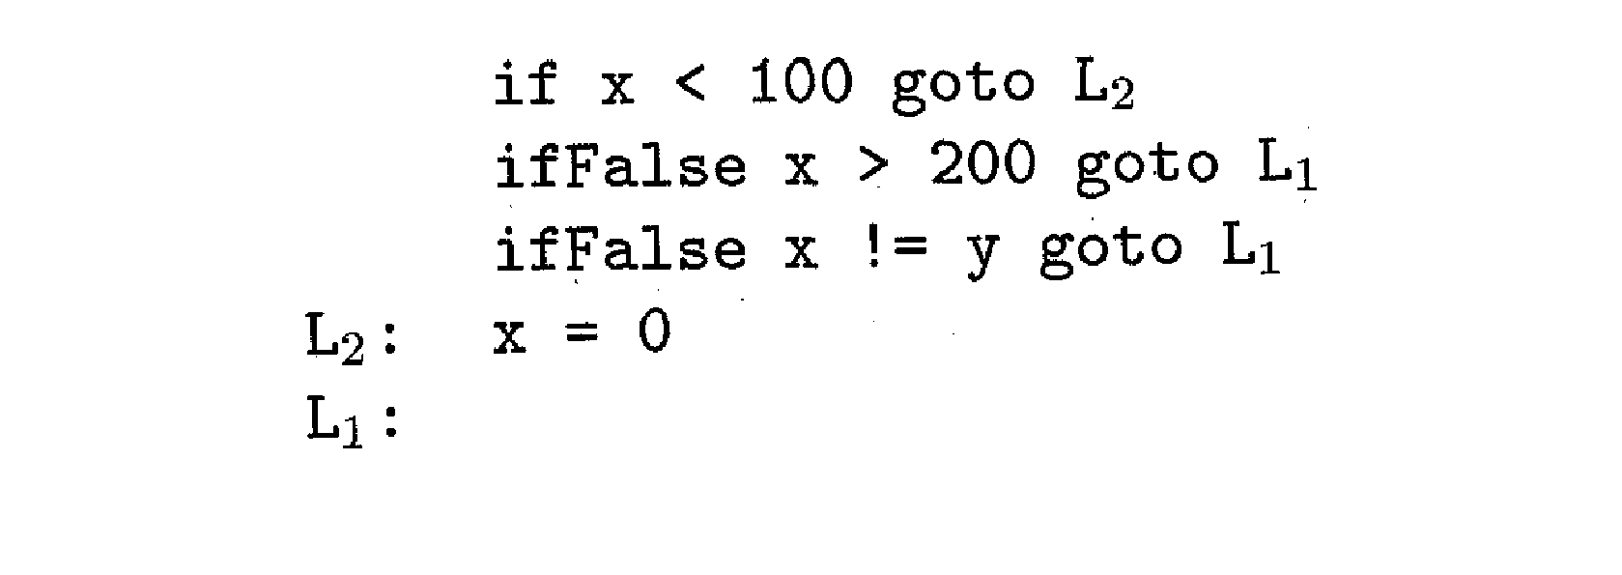
Short-Circuit Code
The statement
might be translated into the code
In this translation, the Boolean expression is true if control reaches label L2.
If the expression is false, control goes immediately to L1, skipping L2 and the assignment x = 0.

Slide 78
Flow-of-Control Statements
Translation of boolean expressions into three-address code in the context of statements generated using the following grammar
S -> if (B) S1
S -> if ( B ) S1 else S2
S -> while ( B ) S1
Non terminal B represents a boolean expression and nonterminal S represents a statement

Slide 79
Boolean Expression
Synthesized attributes associated with Boolean expression and Statement
B.code ,S.code- gives the translation into three-address instructions
Inherited attributes associated with Boolean expression and Statement
B.true - label to which control flows if B is true
B.false - label to which control flows if B is false
S.next - label attached to the first 3-address statement to be executed immediately after the code for S.
Functions used in Syntax directed definitions
newlabel() creates a new label each time it is called
label(L) attaches label L to the next three-address instruction to be generated

Slide 80
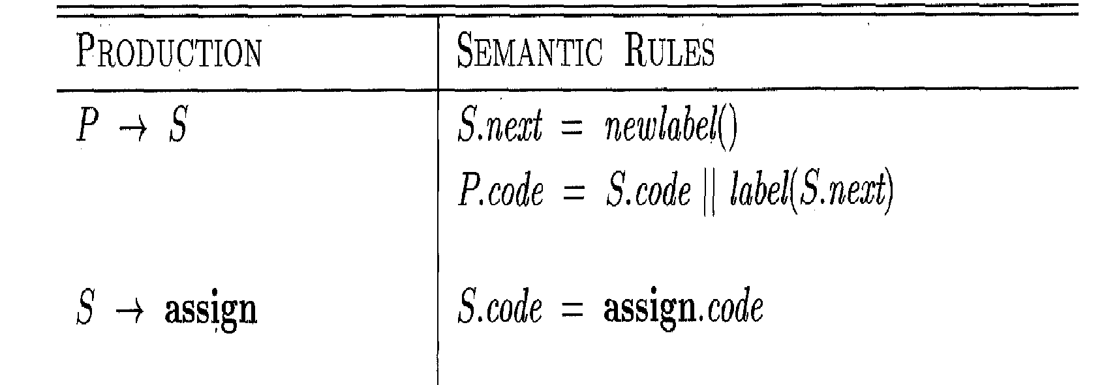
Syntax directed definition for P 🡪 S
P-> S : Program P consist of statement S
S.next is initialized to to a new label
P.code consists of S.code followed by the new label S.next
assign is a placeholder for assignment statements

Slide 81
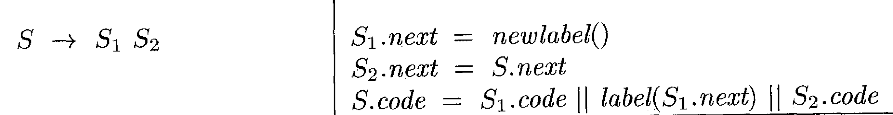
Syntax directed definition for S 🡪 S₁S₂
S1 followed by the code for S2
The first instruction after the code for S1 is the beginning of the code for S2
The instruction after the code for S2 is also the instruction after the code for S.

Slide 82
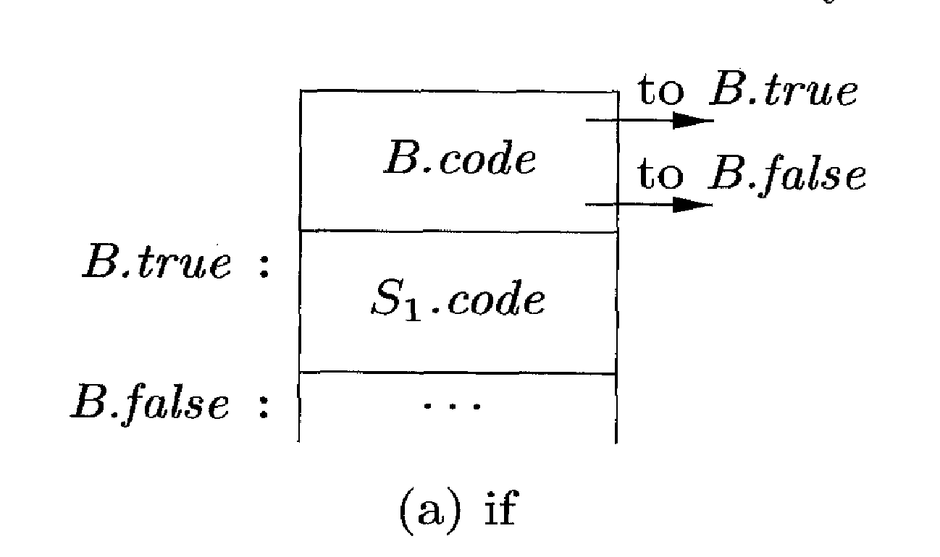
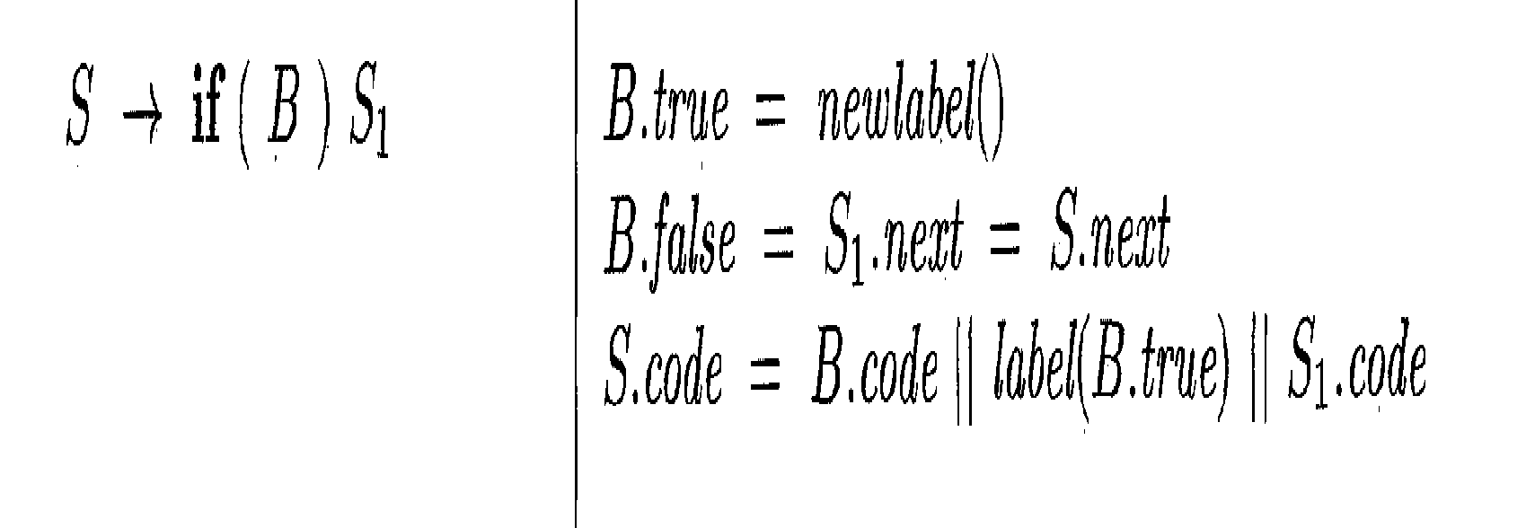
Syntax directed definition for Boolean Expression S -> if (B) S1
Syntax-directed definition
Create a new label B.true and attach it to the first three-address instruction generated for the statement S1
Within B. code are jumps based on the value of B.
If B is true, control flows to the first instruction of S1 .code, and
If B is false, control flows to the instruction immediately following S1.code.
By setting B.false to S.next, we ensure that control will skip the code for S1 if B evaluates to false.

Slide 83
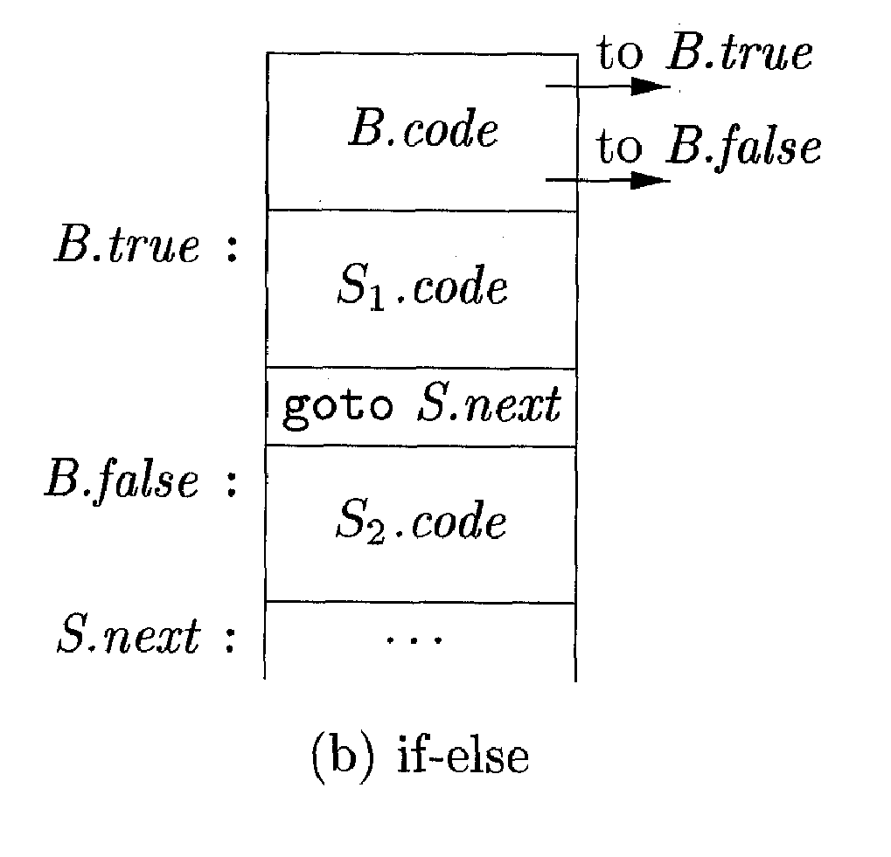
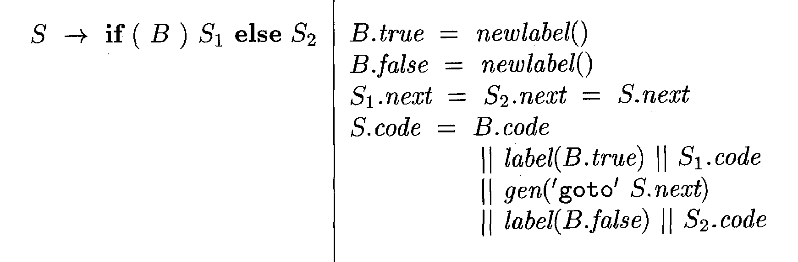
Syntax directed definition for Boolean Expression S -> if ( B ) S1 else S2
Syntax-directed definition
Create two labels B.true and B.false
If B is true, B jumps to the first instruction of the code for S1
If B is false, jumps to the first instruction of the code for S2
Control flows from both S1 and S2 to the three-address instruction immediately following the code for S - its label is given by the inherited attribute S.next.
An explicit goto S.next appears after the code for S1 to skip over the code for S2.
No goto is needed after S2, since S2. next is the same as S. next.

Slide 84
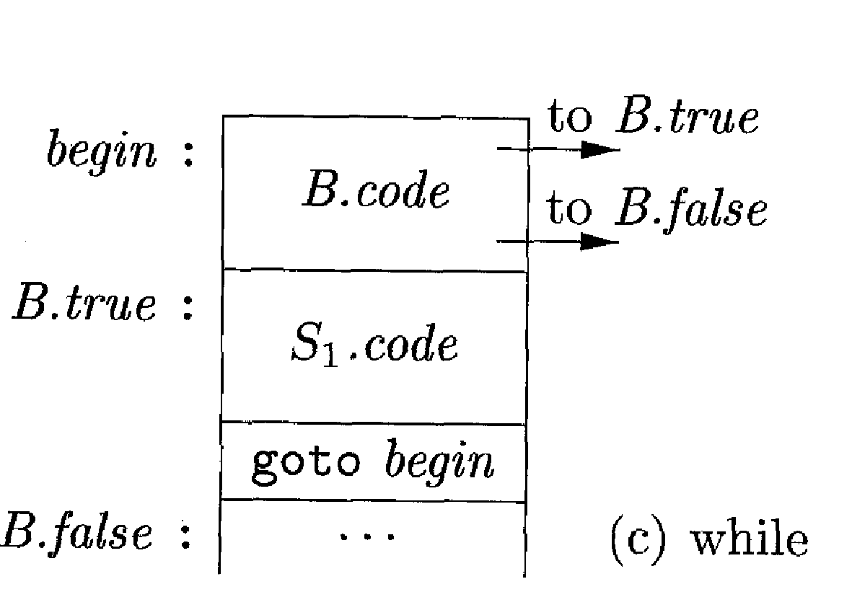
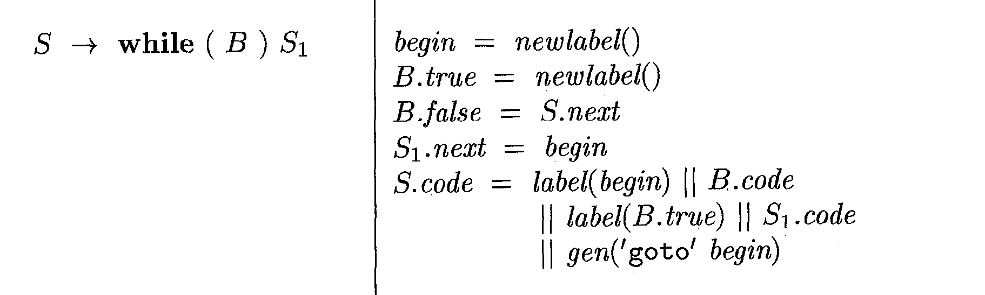
Boolean Expression S 🡪 while (B) S1
Syntax-directed definition
begin – local variable that holds a new label attached to the first instruction for the while-statement, also the first instruction for B.
begin- is a variable rather than an attribute, because begin is local to the semantic rules for this production.
S.next - marks the instruction that control must flow to if B is false; hence, B. false is set to be S.next
B. true - Code for B generates a jump to this label if B is true and attached to the first instruction for S1
goto begin - causes a jump back to the beginning of the code for the boolean expression.
S1 .next is set to this label begin, so jumps from within S1. code can go directly to begin

Slide 85
Control-Flow Translation of Boolean Expressions
Boolean expression B is translated into three-address instructions
B is evaluated using conditional and unconditional jumps to one of two labels:
B.true - if B is true
B.fa1se - if B is false

Slide 86
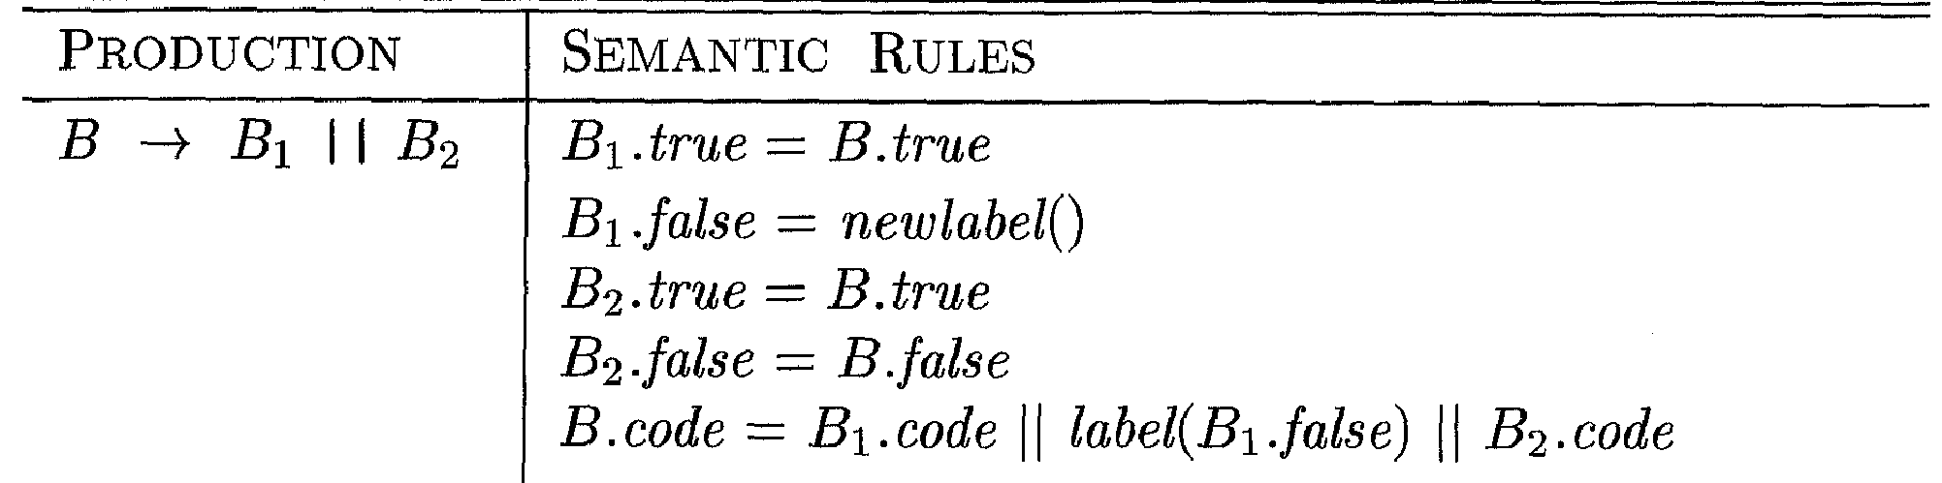
Control-Flow Translation of Boolean Expressions
If B1 is true, then B itself is true, so B1.true is the same as B.true.
If B1 is false, then B2 must be evaluated, so make B1.false be the label of the first instruction in the code for B2.
The true and false exits of B2 are the same as the true and false exits of B, respectively.

Slide 87
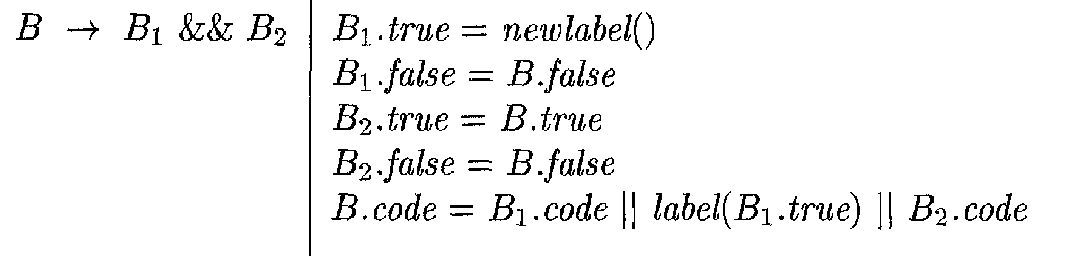
Control-Flow Translation of Boolean Expressions
If B1 is true, then B2 must be evaluated so make B1.true is assigned as the label of the first instruction in the code for B2
If B1 is false, then B itself is false, so B1.false is the same as B.false
If B2 is true, then B itself is true, so B2.true is the same as B.true
If B2 is false, then B itself is false, so B2.false is the same as B.false

Slide 88
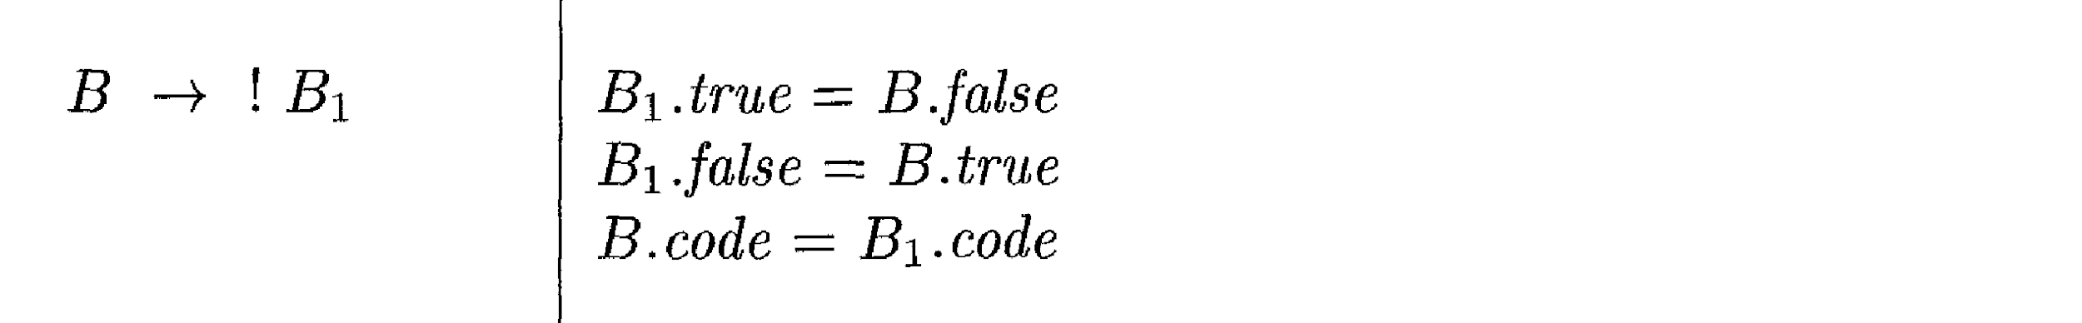
Control-Flow Translation of Boolean Expressions
No code is needed for an expression B of the form ! B1
Interchange the true and false exits of B to get the true and false exits of B1.

Slide 89
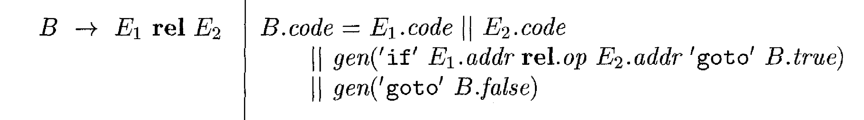

Control-Flow Translation of Boolean Expressions
Translated directly into a comparison three-address instruction with jumps to the appropriate places
For instance, B of the form a < b translates into

Slide 90
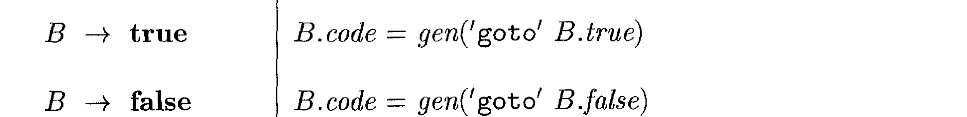
Control-Flow Translation of Boolean Expressions
The constants true and false translate into jumps to B.true and B.false, respectively

Slide 91
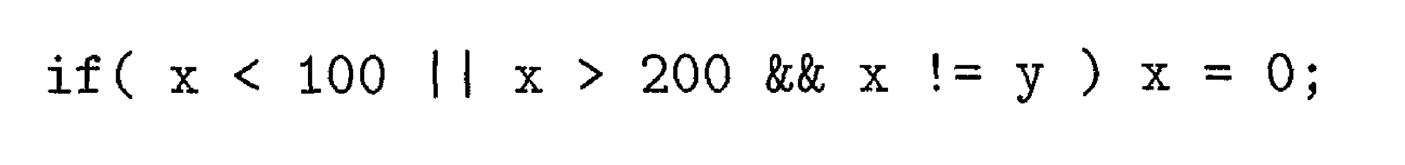
S
Control-Flow Translation of Boolean Expressions -Example
Consider the expression
S
S.next
L1:

Slide 92

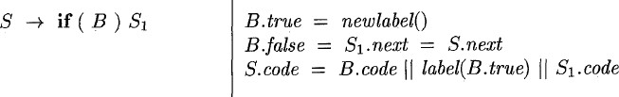
B
S₁
if B.condition goto B.true
goto B.false
L2: x = 0 S₁.code
L1:

Slide 93
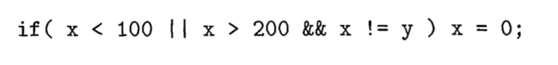
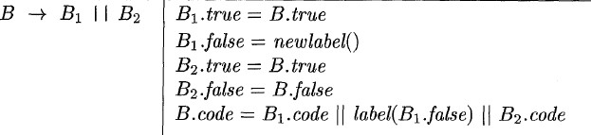
B₁
B₂
If B1.condition goto L2
goto L3
L3:If B2.condition goto L2
goto L1
L2: x = 0
L1:
B₁.true = B.true = L2 B₁.false = L3
B₂.true = B.true = L2 B₂.false = B.false = L1
B.true
B.false

Slide 94

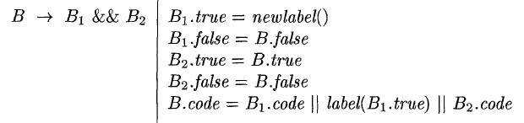
B₁
B₂
If x< 100 goto L2
goto L3
L3: If B2.condition goto L2
goto L1
L2: x = 0
L1:

Slide 95

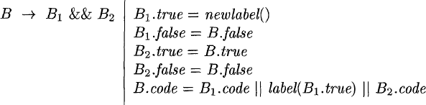
B₁
B₂
If X < 100 goto L2
goto L3
L3: If B2.condition goto L2 goto L1
L2: x = 0
L1:
B₁.true = L4
B₁.false = B.false = L1 B₂.true = B.true = L2 B₂.false = B.false = L1

Slide 96
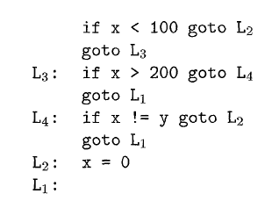
B₁
B₂
Control-Flow Translation of the above statement is
B₁.true = L4
B₁.false = B.false = L1 B₂.true = B.true = L2 B₂.false = B.false = L1
If B1.condition goto L4 goto L1
L4: If B2.condition goto L2
goto L1

Slide 97
Avoiding Redundant Gotos
if x > 200 goto L4 goto L1
L4: …
🡺
ifFalse x > 200 goto L1 L4: …
(fall through)
Translated code of Boolean expressions are not optimized ones
Redundant gotos are noticed
Can be avoided using fallthrough

Slide 98
Using Fall Through
We now adapt the semantic rules for boolean expressions to allow control to fall through whenever possible.
S → if (E) S₁
{E.true = fall; // not newlabel; E.false = S.next;
S₁.next = S.next;
S.code = E.code || S₁.code }
Similarly, the rules for if-else- and while- statements also set E.true to fall.

Slide 99
Using Fall Through Cont’d
E → E₁ || E₂
{E₁.true = if (E.true = fall) then newlabel() else E.true; E₁.false = fall;
E₂.true = E.true; E₂.false = E.false;
E.code = if (E.true = fall) then E₁.code || E₂.code ||
label(E₁.true)
else E₁.code || E₂.code }
E → E₁ && E₂
{E₁.true = fall;
E₁.false = if (E.false = fall) then newlabel() else E.false;
E₂.true = E.true; E₂.false = E.false;
E.code = if (E.false = fall) then E₁.code || E₂.code ||
label(E₁.false)
else E₁.code || E₂.code }

Slide 100
Using Fall Through Cont’d
E → E₁ relop E₂
{test = E₁.addr relop E₂.addr
s = if E.true != fall and E.false != fall then
gen(‘if’ test ‘goto’, E.true) || gen(‘goto’, E.false) else if (E.true != fall) then gen(‘if’ test ‘goto’, E.true)
else if (E.false != fall) then gen(‘ifFalse’ test ‘goto’, E.false)
else ‘’
E.code := E₁.code || E₂ .code || s
}

Slide 101
Using Fall Through Example
if (X < 100 || x > 200 && x != y) x = 0;
=>
if x < 100 goto L2 ifFalse x > 200 goto L1 ifFalse x!=y goto L1
L2: x = 0 L1:

Slide 102
Problems to be solved
Translate the following expressions with and without fall through
If (a==b && c==d || e==f) x==1;
If (a==b || c==d || e==f) x==1;
If (a==b && c==d && e==f) x==1;
If a < b or c < d and e < f
while a < b do
if c<d then
x=y+z
else
x=y-z

Slide 103
Backpatching
A key problem when generating code for boolean expressions and flow-of-control statements is that of matching a jump instruction with the target of the jump.
For example, the translation of the boolean expression B in if ( B ) S contains a jump, for when B is false, to the instruction following the code for S.
In a one-pass translation, B must be translated before S is examined.
What then is the target of the goto that jumps over the code for S?

Slide 104
Backpatching
For the examples of the previous lectures for implementing syntax-directed definitions, the easiest way is to use two passes.
First syntax tree is constructed
Then traversed in depth-first order to compute the translations given in the definition.
Problem in generating three address codes in a single pass for Boolean expressions and flow of control statements is :
We may not know the labels that control must go to at the time jump statements are generated.

Slide 105
Backpatching
This problem is solved by generating a series of branch statements with the targets of the jumps temporarily left unspecified.
Each such statement will be put on a list of goto statements whose labels will be filled in when the proper label can be determined.
This subsequent filling of addresses for the determined labels is called BACKPATCHING.

Slide 106
Backpatching
For implementing Backpatching
Instructions are generated into an instruction array
Labels act as indices to this array.
To manipulate list of labels , three functions are used:
makelist(i)
merge(p1,p2) and
backpatch(p,i)

Slide 107
Backpatching
makelist(i) : creates a new list containing only i, an index into the array of instructions and returns pointer to the list it has made.
merge(i,j) – concatenates the lists pointed to by i and j ,and returns a pointer to the concatenated list.
backpatch(p,i) – inserts i as the target label for each of the statements on the list pointed to by p.

Slide 108
Backpatching
Let’s now try to construct the translation scheme for Boolean expression.
Let the grammar be:
B → B1 or MB2
B → B1 and MB2
B → not B1
B → (B1)
B → id1 relop id2
B → false
B → true
M → ε

Slide 109
Backpatching
What we have done is inserting a marker non-terminal M into the grammar to cause a semantic action to pick up, at appropriate times the index of the next instructionto be generated.
This is done by the semantic action:
{ M.instr = nextinstr; } for the rule M → ε

Slide 110
Backpatching
Two synthesized attributes truelist and falselist of non-terminal B are used to generate jumping code for Boolean expressions.
B.truelist : Contains the list of all the jump statements left incomplete to be filled by the label for the start of the code for B=true.
B.falselist : Contains the list of all the jump statements left incomplete to be filled by the label for the start of the code for B=false.

Slide 111
Backpatching
The variable nextinstr holds the index of the next instruction to follow.
This value will be backpatched onto B₁.truelist in case of B → B1 and MB2 where it contains the address of the first statement of B₂.code.
This value will be backpatched onto B₁.falselist in case of B → B1 or MB2 where it contains the address of the first statement of B₂.code.

Slide 112
Backpatching-Boolean expressions
We use the following semantic actions for the above grammar :
1) B → B₁ or M B₂
backpatch(B₁.falselist, M.instr)
B.truelist = merge(B₁.truelist, B₂.truelist)
B.falselist = B₂.falselist
If B1 is true, then B is also true, so the jumps on B1. truelist become part of B.truelist.
If B1 is false, we must next test B2, so the target for the jumps B1.falselist must be the beginning of the code generated for B2.
This target is obtained using the marker nonterminal M.
M produces, as a synthesized attribute M.instr, the index of the next instruction, just before B2 code starts being generated
The value M.instr will be backpatched onto the B1 .falselist (i.e., each instruction on the list B1. falselist will receive M.instr as its target label) when we have seen the remainder of the production B -> B1 or M B2.

Slide 113
Backpatching -Boolean expressions
2)B → B₁ and M B₂
backpatch(B₁.truelist, M.instr)
B.truelist = B₂.truelist
B.falselist = merge(B₁.falselist, B₂.falselist)
If B1 is true, we must next test B2, so the target for the jumps B1. truelist must be the beginning of the code generated for B2.
This target is obtained using the marker nonterminal M.instr , the index of the next instruction, just before B2 code starts being generated
The value M.instr will be backpatched onto the B1.truelist.
If B1 is false, then B is also false, so the jumps on B1. falselist become part of B.falselist.

Slide 114
Backpatching -Boolean expressions
Swaps the true and false lists
3) B → not B₁
B.truelist = B₁.falselist
B.falselist = B₁.truelist
4) B → (B₁)
B.truelist = B₁.truelist
B.falselist = B₁.falselist
5) B → id₁ relop id₂
B.truelist = makelist(nextinstr)
B.falselist = makelist(nextinstr+1 )
emit(if id₁.place relop id₂.place goto __ )
emit(goto ___)
Ignores parenthesis
generates two instructions, a conditional goto and an unconditional one.
Both gotos have unfilled targets
These instructions are put on B.truelist and B.falselist, respectively

Slide 115
Backpatching-Boolean expressions
6) B → true
B.truelist = makelist(nextinstr)
emit(goto ___)
7) B → false
E.falselist = makelist(nextinstr)
emit(goto ___)
8) M → ε
M.instr = nextinstr;

Slide 116
Backpatching-Boolean expressions Example
Expression of of the form B → B₁ or M B₂
Consider the expression
B
B1
B2
B → B₁ or M B₂
backpatch(B₁.falselist, M.instr)
B.truelist = merge(B₁.truelist, B₂.truelist)
B.falselist = B₂.falselist

Slide 117
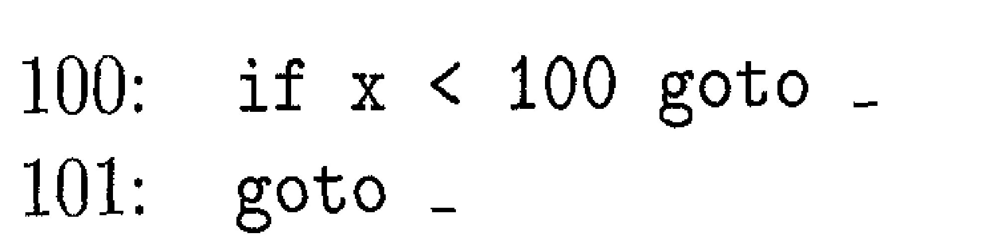
Backpatching-Boolean expressions Example
B
B1
B2
B → id₁ relop id₂
B.truelist = makelist(nextinstr)
B.falselist = makelist(nextinstr+1 )
emit(if id₁.place relop id₂.place goto __ )
emit(goto ___)

Slide 118
Backpatching-Boolean expressions Example
Expression of of the form B → B₁ or M B₂
B
B1
B2
The marker nonterminal M in the production records the value of nextinstr, which at this time is 102
B → B₁ or M B₂
backpatch(B₁.falselist, M.instr)
B.truelist = merge(B₁.truelist, B₂.truelist)
B.falselist = B₂.falselist

Slide 119
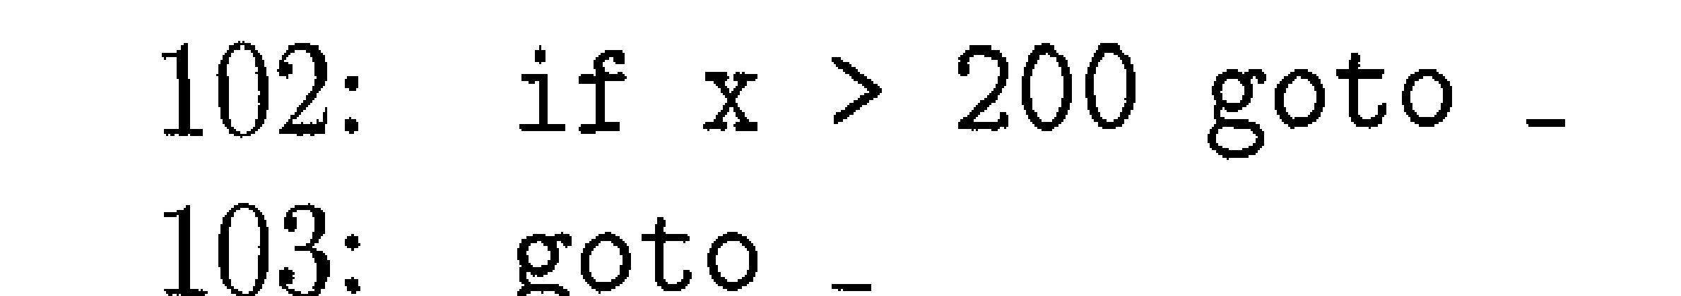
Backpatching-Boolean expressions Example
B
B1
B2
B → id₁ relop id₂
B.truelist = makelist(nextinstr)
B.falselist = makelist(nextinstr+1 )
emit(if id₁.place relop id₂.place goto __ )
emit(goto ___)

Slide 120
Backpatching-Boolean expressions Example
B
B1
B2
The marker nonterminal M in the production records the value of nextinstr, which at this time is 104
2)B → B₁ and M B₂
backpatch(B₁.truelist, M.instr)
B.truelist = B₂.truelist
B.falselist = merge(B₁.falselist, B₂.falselist)

Slide 121
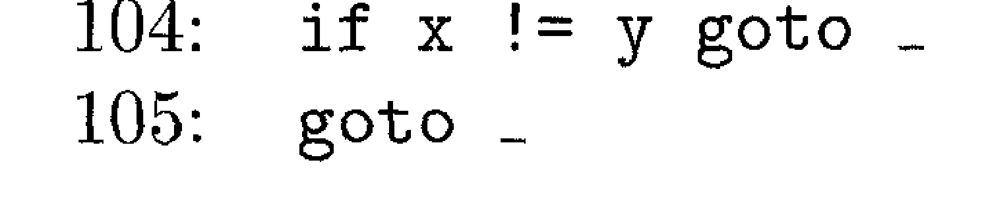
Backpatching-Boolean expressions Example
B
B1
B2
B → id₁ relop id₂
B.truelist = makelist(nextinstr)
B.falselist = makelist(nextinstr+1 )
emit(if id₁.place relop id₂.place goto __ )
emit(goto ___)

Slide 122
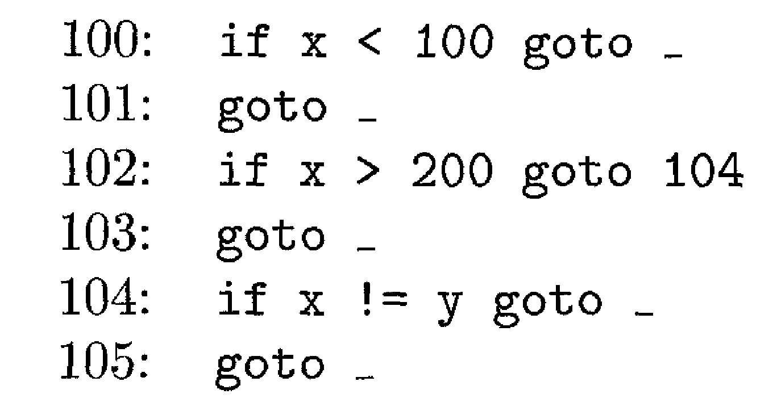
Backpatching -Boolean expressions Example
B
B1
B2
B₁.truelist =102
M.instr=104
backpatch(102,104) – instruction in 102 is filled with 104
2)B → B₁ and M B₂
backpatch(B₁.truelist, M.instr)
B.truelist = B₂.truelist
B.falselist = merge(B₁.falselist, B₂.falselist)

Slide 123
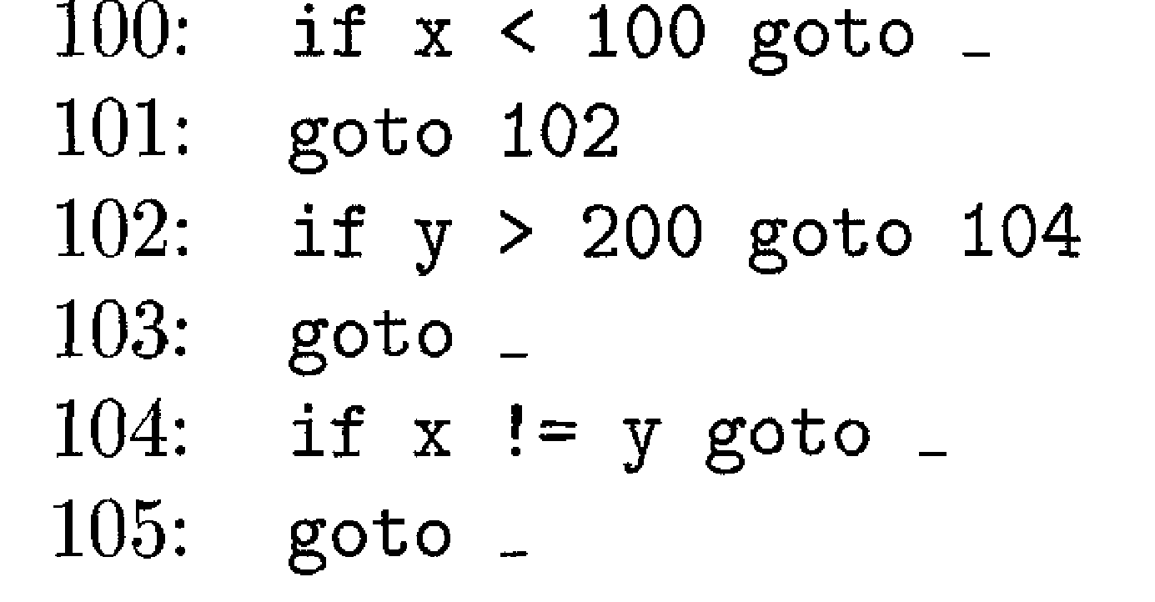
Backpatching-Boolean expressions Example
Expression of of the form B → B₁ or M B₂
B
B2
B1
B₁.falselist =101
M.instr=102
backpatch(101,102) – instruction in 101 is filled with 102
B → B₁ or M B₂
backpatch(B₁.falselist, M.instr)
B.truelist = merge(B₁.truelist, B₂.truelist)
B.falselist = B₂.falselist

Slide 124
Backpatching-Boolean expressions Example
B
The entire expression is true if and only if the gotos of instructions 100
or 104 are reached
Expression is false if and only if the gotos of instructions 103 or 105 are reached.

Slide 125
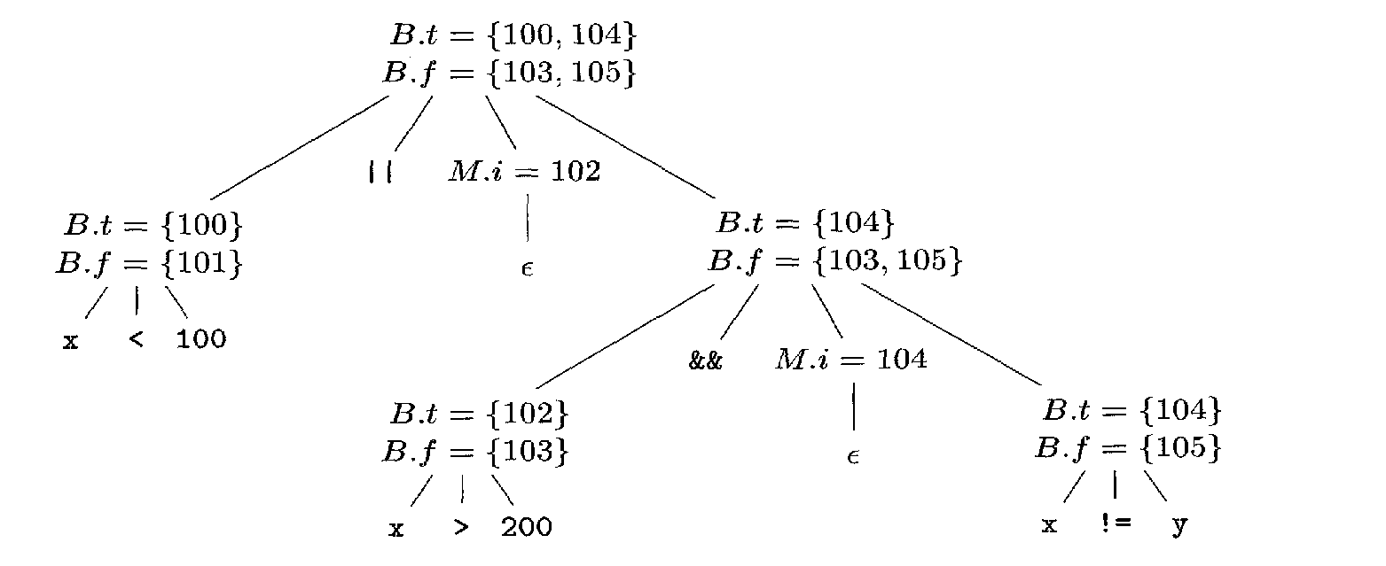
Backpatching-Boolean expressions Example
Annotated parse tree for

Slide 126
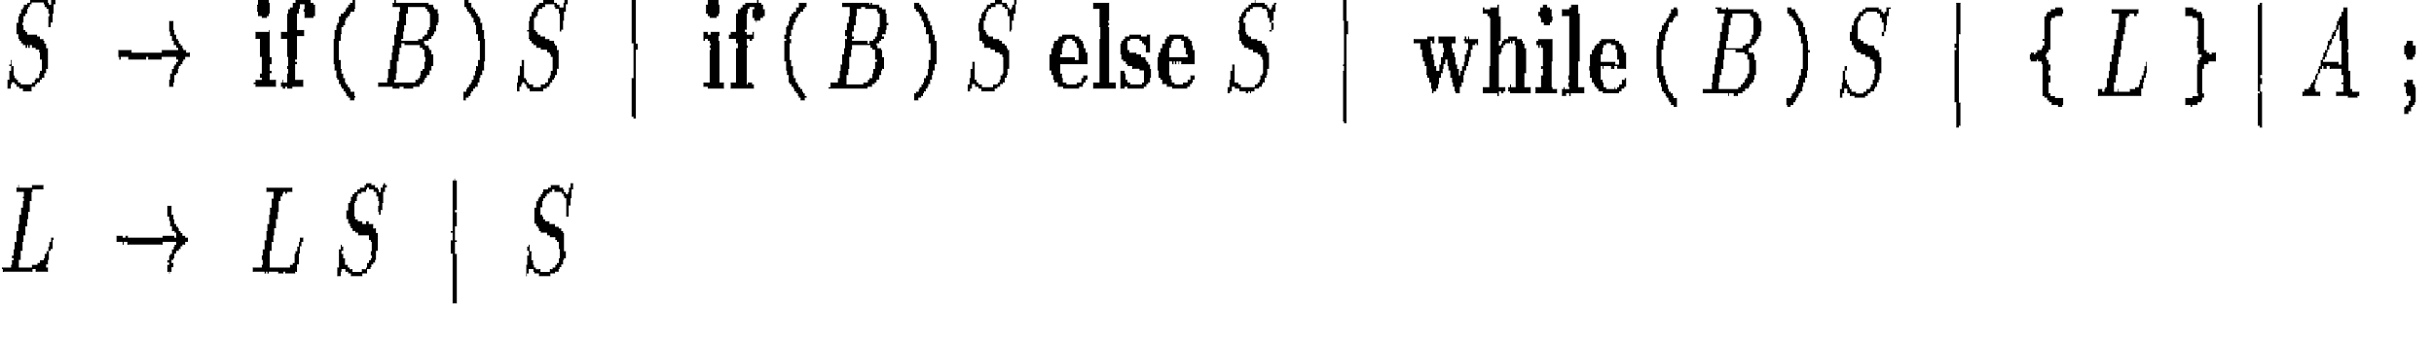
Backpatching-Flow of control
Backpatching can be used to translate flow-of-control statements in one pass.
Consider statements generated by the following grammar:
S denotes a statement
L denotes statement list
B denotes boolean expression

Slide 127
Backpatching-Flow of control
Boolean expressions generated by nonterminal B have two lists of jumps
B. truelist -Contains the list of all the jump statements left incomplete to be filled by the label for the start of the code for B=true.
B.falselist-Contains the list of all the jump statements left incomplete to be filled by the label for the start of the code for B=false.
Statements generated by nonterminals S and L have a list of unfilled jumps
Eventually filled by backpatching.
S.nextlist - list of all conditional and unconditional jumps to the instruction following the code for statement S in execution order.
L.nextlist - list of all conditional and unconditional jumps to the instruction following the code for statement L in execution order

Slide 128
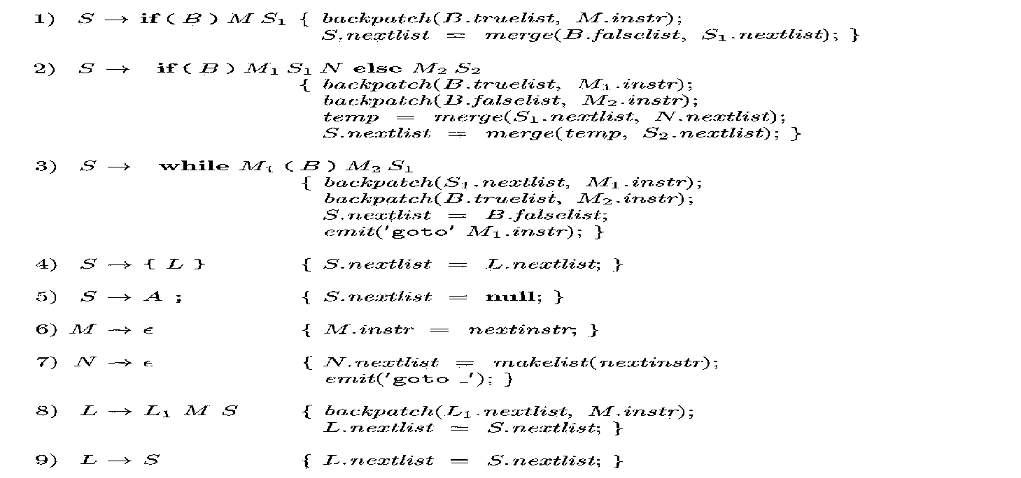
Backpatching-Translation of Flow of control statements

Slide 129
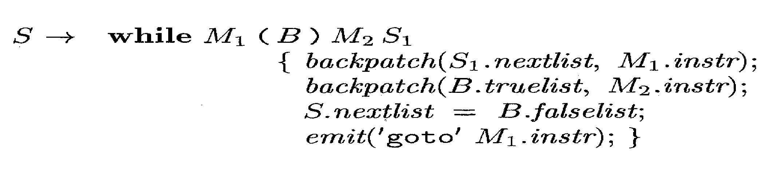
Backpatching-Flow of control
In the above production
Two occurrences of the marker nonterminal M
Used to record the instruction numbers of the beginning of the code for B and the beginning of the code for S1
For the rule M → ε , semantic action is { M.instr = nextinstr; }
After the body S1 of the while-statement is executed, control flows to the beginning.
When the entire production is reduced to S, S1.nextlist is backpatched to make all targets on that list be M1.instr.
An explicit jump to the beginning of the code for B is appended after the code for S1 because control may also "fall out the bottom."
B.truelist is backpatched to go to the beginning of S1 by making jumps on B. truelist go to M2 . instr.

Slide 130
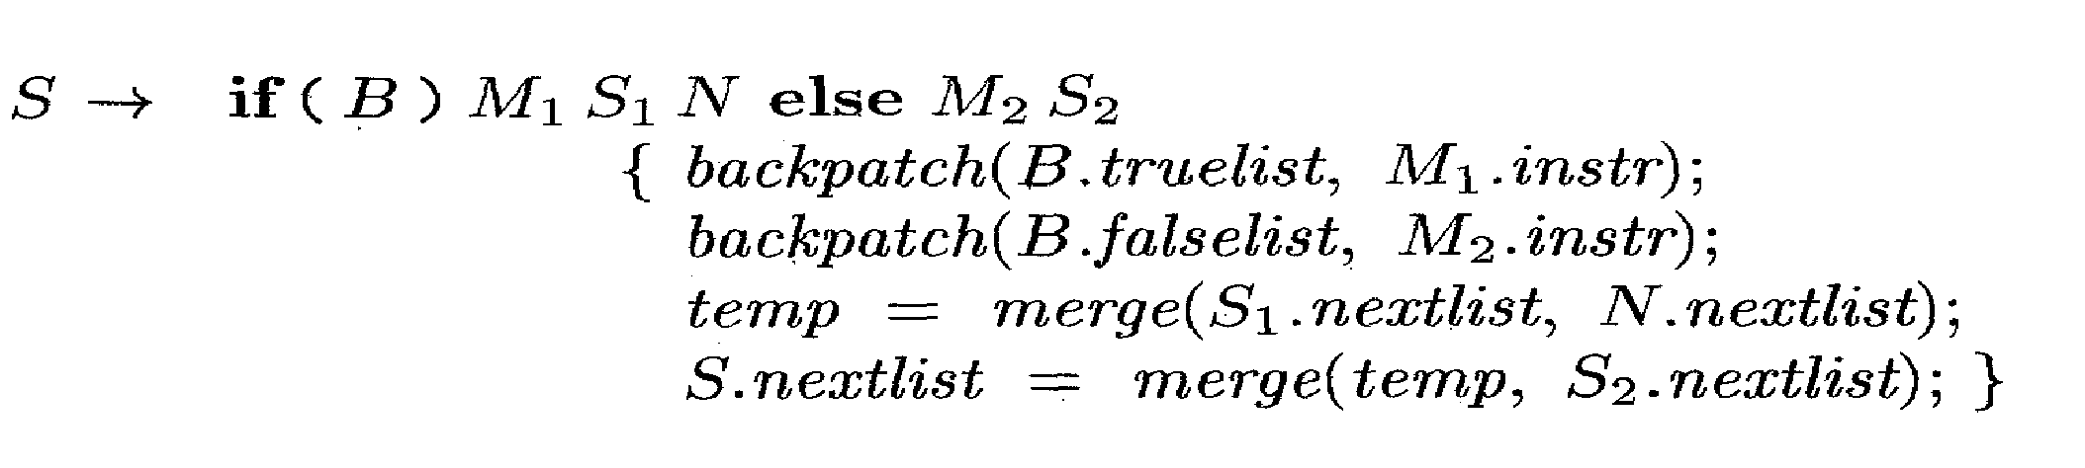
Backpatching-Flow of control
If control "falls out the bottom" of S1, as when S1 is an assignment
code has to be included at the end of S1 to jump to S2
A new nonterminal N with production N → ε is introduced for this purpose
N has attribute N.nextlist, which will be a list consisting of the instruction number of the jump goto - that is generated by the semantic action (7) for N.
When B is true, jumps are backpatched to the instruction M1.instr;
Similarly, when B is false jumps are backpatched to the beginning of the code for S2.
S.nextlist includes all jumps out of S1 and S2, as well as the jump generated by N.
temp is a temporary variable that is used only for merging lists.

Slide 131

Backpatching-Flow of control
Above two productions handle sequences of statements.
In L -> L₁ M S
Instruction following the code for L1 in order of execution is the beginning of S.
Thus the L1 .nextlist list is backpatched to the beginning of the code for S, which is given by M. instr.
In L -> S , L. nextlist is the same as S.nextlist

Slide 132
Backpatching-Flow of control
No new instructions are generated anywhere in these semantic
rules, except for rules (3) and (7).
All other code is generated by the semantic actions associated with assignment-statements and expressions.
The flow of control causes the proper backpatching so that the assignments and Boolean expression evaluations will connect properly.

Slide 133
Labels and Goto Statements
Labels are stored in the symbol table (and associated with intermediate language labels).
Generated as soon as a jump or a declaration is met (to avoid one additional pass)
For “goto L”, we have to change L into the address of the three-address code for the statement where L is attached.
When L’s address has been found, we can do this easily with the information in the symbol table.
Otherwise, we have to use backpatching. We keep the list of address to be filled in the symbol table

Slide 134
Break and Continue Statements
Break/exit: pass an additional (inherited) attribute to the translation function of loops with the label a break/exit should jump to.
A new label is passed when entering a new loop
A break-statement is a jump to the first instruction after the code for the enclosing statement S.
keep track of the enclosing statement S
generate an unfilled jump for the break- statement
put the unfilled jump on S.nextlist
backpatch when the exit place is known

Slide 135
Break and Continue Statements
Continue statements :
can be handled in a manner analogous to the break statement.
The main difference between the two is that the target of the generated jump is different

Slide 136

Translation of a switch-statement
The "switch" or "case" statement is available in a variety of languages.
switch-statement syntax is shown below .
There is a selector expression E, which is to be evaluated
Followed by n constant values Vl , V2, . . - , Vn that the expression might take
Has a default "value," which always matches the expression if no other value does.

Slide 137
Translation of a switch-statement
The intended translation of a switch is code to:
1. Evaluate the expression E.
2. Find the value V, in the list of cases that is the same as the value of the expression. Recall that the default value matches the expression if none of the values explicitly mentioned in cases does.
3. Execute the statement Sj associated with the value found.

Slide 138
Translation of a switch-statement
Step (2) is an n-way branch, which can be implemented in one of several ways.
If the number of cases is small (say 10 at most)
use a sequence of conditional jumps
each jump tests for an individual value and transfers to the code for the corresponding statement.
Way to implement this sequence of conditional jumps is to create a table of pairs
each pair consisting of a value and a label for the corresponding statement's code.
The value of the expression itself, paired with the label for the default statement is placed at the end of the table at run time.
A simple loop generated by the compiler compares the value of the expression with each value in the table
if no other match is found, the last (default) entry is sure to match

Slide 139
Translation of a switch-statement
If the number of values exceeds 10
Create hash table for the values, with the labels of the various statements as entries.
If no entry for the value possessed by the switch expression is found, a jump to the default statement is generated
Special case that can be implemented even more efficiently than by an n-way branch.
If the values all lie in range, say min to max
number of different values is a reasonable fraction of max - min
then we can construct an array of max-- min "buckets," where bucket j - min contains the label of the statement with value j
any bucket that would otherwise remain unfilled contains the default label.

Slide 140
Translation of a switch-statement
To perform the switch, evaluate the expression to obtain the value j;
Check that it is in the range min to max
transfer indirectly to the table entry at offset j - min.
For example, if the expression is of type character, a table of, say, 128 entries (depending on the character set) may be created and transferred through with no range testing

Slide 141

Syntax-Directed Translation of Switch-Statements
A convenient translation of the switch statement is
All tests appear at the end
A simple code generator can recognize the multiway branch and generate efficient code for it

Slide 142
Syntax-Directed Translation of Switch-Statements
When the keyword switch is noticed
generate two new labels test and next, and a new temporary t.
parse the expression E and generate code to evaluate E into t.
After processing E, generate the jump goto test .
When the keyword case is noticed
create a new label L_{i} and enter it into the symbol table.
Each value-label pair consisting of the value V, of the case constant and L_{i} (or a pointer to the symbol-table entry for L_{i}) is placed in a queue
We process each statement case V, : S_{i} by emitting the label L_{i} attached to the code for S_{i} followed by the jump goto next.

Slide 143

Syntax-Directed Translation of Switch-Statements
When the end of the switch is found
generate the code for the n-way branch.
Read the queue of value-label pairs
generate a sequence of three-address statements of the form shown below.
t is the temporary holding the value of the selector expression E
L_{n}, is the label for the default statement

Slide 144

Syntax-Directed Translation of Switch-Statements
Another form of translation of switch case
Compiler should emit code for each of the statements S_{i} as it notices.
Hence it is tedious for one-pass compiler to place the branching statements at the beginning
This form of translation is not effective

Slide 145
Procedure Calls
Must generate the calling sequence and returning sequence.
Can be done either at the calling or at the called procedure – depending on machine and OS.

Slide 146
Procedure Calls
S → call id ( Elist )
Elist → Elist , E
Elist → E
Calling sequence
allocate space for activation record
evaluate arguments
establish environment pointers
save status and return address
jump to the beginning of the procedure
‹#›
Notes:
‹#›
calling sequences
allocate space for activation record (AR) on stack
evaluate arguments to procedure and make available at known location
save state of calling procedure - used to resume execution after call
save return address (in known location) (instruction following call)
generate jump to the beginning of the called procedure
return sequence
if a function, save the result(s) in a known place
restore the activation record of the calling procedure
generate a jump to the return address (of calling procedure)

Slide 147
Procedure Calls …
Example
parameters are passed by reference
storage is statically allocated
use param statement as place holder for the arguments
called procedure is passed a pointer to the first parameter
pointers to any argument can be obtained by using proper offsets
‹#›
Notes:
‹#›
Consider the example given in the last slide. The parameters are passed by reference and have statically allocated storage.

Slide 148
Code Generation for procedure calls
Generate three address code needed to evaluate arguments which are expressions
Generate a list of param three address statements
Store arguments in a list
S → call id ( Elist )
for each item p on queue do emit('param' p)
emit('call' id.place)
Elist → Elist , E
append E.place to the end of queue
Elist → E
initialize queue to contain E.place
‹#›
Notes:
‹#›
For code generation, we generate three address code which is needed to evaluate arguments that are in fact expressions. As a result a list of param three address statements are generated.
This is a syntax-directed translation and gives:
param p₁; param p₂; param p_{n}; call id.place
Note that each of the expression will also generate 3ac code

Slide 149

Code Generation

Slide 150
Code Generation
Requirements
Preserve semantic meaning of source program
Make effective use of available resources of target machine
Code generator itself must run efficiently
Challenges
Problem of generating optimal target program is undecidable
Many subproblems encountered in code generation are computationally intractable

Slide 151
Main Tasks of Code Generator
Instruction selection: choosing appropriate target-machine instructions to implement the IR statements
Registers allocation and assignment: deciding what values to keep in which registers
Instruction ordering: deciding in what order to schedule the execution of instructions

Slide 152
Issues in the Design of a Code Generator
Input to the Code Generator
The Target Program
Instruction Selection
Register Allocation
Evaluation Order

Slide 153
Input to the Code Generator
The input to the code generator is the intermediate representation of the source program
Three-address representations | quadruples, triples, indirect triples;
Virtual machine representations | Bytecodes and stack-machine code
Linear representations | Postfix notation
Graphical representations | Syntax trees and DAG's
Here it is assume that all syntactic and static semantic errors have been detected, that the necessary type checking has taken place, and that type conversion operators have been inserted wherever necessary.
The code generator can therefore proceed on the assumption that its input is free of
these kinds of errors.

Slide 154
The Target Program
The instruction-set architecture of the target machine has a significant impact on the difficulty of constructing a good code generator that produces high-quality machine code.
The most common target-machine architectures are
RISC (reduced instruction set computer)
It has many registers, three-address instructions, simple addressing modes, and a relatively simple instruction-set architecture
CISC (complex instruction set computer),
It has few registers, two-address instructions, a variety of addressing modes, several
register classes, variable-length instructions, and instructions with side effects
Stack based
operations are done by pushing operands onto a stack and then performing the
operations on the operands at the top of the stack

Slide 155
The Target Program (Cont)
To overcome the high performance penalty of interpretation, just-in-time
(JIT) Java compilers have been created.
These JIT compilers translate bytecodes during run time to the native hardware instruction set of the target machine
Producing an absolute machine-language program as output has the advantage that it can be placed in a fixed location in memory and immediately executed
Producing a relocatable machine-language program (often called an object module) as output allows subprograms to be compiled separately. A set of relocatable object modules can be linked together and loaded for execution by a linking loader.

Slide 156
Instruction Selection
The code generator must map the IR program into a code sequence
that can be executed by the target machine.
The complexity of performing this mapping is determined by a factors such as
The level of the IR
The nature of the instruction-set architecture
The desired quality of the generated code.

Slide 157
Instruction Selection
If the IR is high level, the code generator may translate each IR statement into a sequence of machine instructions using code templates. Such statement by-statement code generation, however, often produces poor code that needs
If the IR reflects some of the low-level details of the underlying machine, then the code generator can use this information to generate more efficient code sequences.
The quality of the generated code is usually determined by its speed and
size.
On most machines, a given IR program can be implemented by many different code sequences, with significant cost differences between the different implementations

Slide 158
Register Allocation
A key problem in code generation is deciding what values to hold in what registers.
Registers are the fastest computational unit on the target machine, but we usually do not have enough of them to hold all values.
Values not held in registers need to reside in memory.
Instructions involving register operands are invariably shorter and faster than those involving operands in memory, so efficient utilization of registers is particularly important.
The use of registers is often subdivided into two sub-problems:
Register allocation, during which we select the set of variables that will reside in registers at each
point in the program.
Register assignment, during which we pick the specific register that a variable will reside in.
Finding an optimal assignment of registers to variables is difficult, even with single-
register machines.
Mathematically, the problem is NP-complete.
The problem is further complicated because the hardware and/or the operating system of the target machine may require that certain register-usage conventions be observed.

Slide 159
Evaluation Order
The order in which computations are performed can affect the efficiency of the target code.
Some computation orders require fewer registers to hold
intermediate results than others.
However, picking a best order in the general case is a difficult NP-
complete problem.
Initially, we shall avoid the problem by generating code for the three- address statements in the order in which they have been produced by the intermediate code generator.
Prepared by R I Minu

Slide 160
Simple Code Generator
Content..
Introduction(Simple Code Generator)
Register and Address Descriptors
A Code-Generation Algorithm
The Function getreg
Generating Code for Other Types of Statements

Slide 161
Introduction
Code Generator:
Code generator can be considered as the final phase of compilation.
It generates a target code for a sequence of three-address statement.
It consider each statement in turn, remembering if any of the operands of the statement are currently in registers, and taking advantage of that fact if possible.

Slide 162
Introduction
We assume that computed results can be left in registers an long as possible.
Storing them only
if their register is needed for another computation (or)
Just before a procedure call, jump, or labeled statement
Condition (b)implies that everything must be stored just before the end of a basic block.

Slide 163
Introduction
The reason we must do so is that, after leaving a basic block, we may be able to go to several different blocks, or we may go to one particular block that can be reached from several others.
In either case, we cannot, without extra effort, assume that a datum used by a block appears in the same register no matter how control reached that block.
Thus, to avoid a possible error, our simple code- generator algorithm stores everything when moving across basic block boundaries as well as when procedure calls are made.

Slide 164
Introduction
We can produce reasonable code for a three- address statement a:=b+c
If we generate the single instruction ADD Rj,Ri
with cost one
If Ri contain b but c is in a memory location, we can generate the sequence
Add c,Ri
(or)
Mov c,Rj Add Rj, Ri
cost=2
cost=3

Slide 165
Register and Address Descriptors
The code generator has to track both the registers (for availability) and addresses (location of values) while generating the code. For both of them, the following two descriptors are used:
Register descriptor
Address descriptor

Slide 166
Register descriptor
Register descriptor is used to inform the code generator about the availability of registers. Register descriptor keeps track of values stored in each register. Whenever a new register is required during code generation, this descriptor is consulted for register availability.
Keep track of what is currently in each register.
Initially all the registers are empty

Slide 167
Address descriptor
Values of the names (identifiers) used in the program might be stored at different locations while in execution. Address descriptors are used to keep track of memory locations where the values of identifiers are stored. These locations may include CPU registers, heaps, stacks, memory or a combination of the mentioned locations.
Keep track of location where current value of the name can be found at runtime
The location might be a register, stack, memory address or a set of those

Slide 168
A Code-Generation Algorithm
Basic blocks comprise of a sequence of three- address instructions. Code generator takes these sequence of instructions as input.
For each three-address statement of the form
x:=y op z
we perform the following actions

Slide 169
Call function getReg, to decide the location of L.
Determine the present location (register or memory) of y by consulting the Address Descriptor of y. If y is not presently in register L, then generate the following instruction to copy the value of y to L
MOV y’, L
where y’ represents the copied value of y.

Slide 170
Determine the present location of z using the same method used in step 2 for y and generate the following instruction:
OP z’, L
where z’ represents the copied value of z.
Now L contains the value of y OP z, that is intended to be assigned to x. So, if L is a register, update its descriptor to indicate that it contains the value of x. Update the descriptor of x to indicate that it is stored at location L.
If y and z has no further use, they can be given back to the system.

Slide 171
The Function getreg
Code generator uses getReg function to determine the status of available registers and the location of name values. getReg works as follows:
If variable Y is already in register R, it uses that register.
Else if some register R is available, it uses that register.
Else if both the above options are not possible, it chooses a register that requires minimal number of load and store instructions.

Slide 172
The Function getreg
If Y is in register (that holds no other values) and Y is not live and has no next use after
X = Y op Z
then return register of Y for L.
Failing (1) return an empty register
Failing (2) if X has a next use in the block or op
requires register then get a register R, store its content into M (by Mov R, M) and use it.
else select memory location X as L

Slide 173
Example
For example, the assignment d := (a - b) + (a -
c) + (a - c) might be translated into the following three-address code sequence:
t₁ = a – b
t₂ = a – c
t₃ = t₁ + t₂
d = t₃ + t₂

Slide 174
Example
Stmt t₁=a-b | code mov a,R₀ | reg desc R₀ contains t₁ | addr desc t₁ in R₀
 | sub b,R₀
t₂=a-c | mov a,R₁ | R₀ contains t₁ | t₁ in R₀
 | sub c,R₁ | R₁ contains t₂ | t₂ in R₁
t₃=t₁+t₂ | add R₁,R₀ | R₀ contains t₃ | t₃ in R₀
 |  | R₁ contains t₂ | t₂ in R₁
d=t₃+t₂ | add R₁,R₀ | R₀ contains d | d in R₀
 | mov R₀,d |  | d in R₀ and
 |  |  | memory

Slide 175
Generating Code for Other Types of Statements
Indexed assignment
a:=b[i] and
a[i]:=b
Pointer assignment
a:=*p and
*p:=a

Slide 176


Slide 177


Slide 178


Slide 179


Slide 180
Cross Compilation
A cross compiler is a compiler capable of creating executable code for a platform other than the one on which the compiler is run.
Cross compiler tools are used to generate executables for embedded system or multiple platforms.
It is used to compile for a platform upon which it is not feasible to do the compiling, like microcontrollers that don't support an operating system.

Slide 181
Uses of cross compilers
The fundamental use of a cross compiler is to separate the build environment from target environment. This is useful in a number of situations:
Embedded computers where a device has extremely limited resources.
For example, a microwave oven will have an extremely small computer to read its touchpad and door sensor, provide output to a digital display and speaker, and to control the machinery for cooking food.
This computer will not be powerful enough to run a compiler, a file system, or a development environment.
Since debugging and testing may also require more resources than are available on an embedded system, cross-compilation can be less involved and less prone to errors than native compilation.

Slide 182
Compiling for multiple machines
For example, a company may wish to support several different versions of an operating system or to support several different operating systems.
By using a cross compiler, a single build environment can be set up to compile for each of these targets.
Compiling on a server farm.
Similar to compiling for multiple machines, a complicated build that involves many compile operations can be executed across any machine that is free, regardless of its underlying hardware or the operating system version that it is running.

Slide 183
GCC and cross compilation
GCC, a free software collection of compilers, can be set up to cross compile. It supports many platforms and languages.

Slide 184
T-diagrams
Different diagrams for different kinds of programs
Visual explanation of interactions involving compilers and interpreters

Slide 185
Programs
Program P written in language L
Example: Sort program written in Java
P
sort
L
Java

Slide 186
Machines
Machine executing language M
Example: Sun workstation executing SPARC machine code
M
sparc

Slide 187
Executing Programs
Program implementation language must match machine
sort
sparc
sparc

Slide 188
Interpreters
Interpreter executing language L written in language M
Example: Lisp interpreter running on sparc
L
Lisp
M
sparc

Slide 189
Interpreting Programs
Interpreter mediates between programming language and machine language
sort
Lisp
Lisp
sparc
sparc

Slide 190
Virtual Machines
Interpreter creates a “virtual machine”
sort
sort
Lisp
Lisp
Lisp
sparc
Lisp
sparc

Slide 191
Compilers
Compiler translating from source language S to target language T implemented in M
Example: C compiler for sparc platform
S
-->
T
C
📫📫✇
sparc
M
sparc

Slide 192
Compiling Programs
Compiler inputs program in source language, outputs in target language
sort
sort
sort
C
C
📫📫✇
sparc
sparc
sparc
sparc
sparc
sparc

Slide 193
Compiler Correctness
Compiled target program has the same meaning as the source program
sort
sort
C
==
sparc
C
sparc

Slide 194
Java Programming Environment
Javac: Java to Java byte code (JBC) compiler
Java: Java Virtual Machine byte code interpreter
P
P
P
Java
Java
📫📫✇
JBC
JBC
JBC
M
JBC
“javac”
M
“java”
M
M

Slide 195
Where Do Compilers Come From?
Write it in machine code
L
📫📫✇
M
M
A lot of work

Slide 196
Where Do Compilers Come From?
Write it in machine code
Write it in a lower level language and compile it using an existing compiler
L
📫📫✇
M
L
📫📫✇
M
C
C
📫📫✇
M
M
M
But where did the C compiler come from?

Slide 197
Where Do Compilers Come From?
Write it in machine code
Write it in a lower level language and compile it using an existing compiler
Write it in the same language that it compiles and bootstrap
L
📫📫✇
M
L

Slide 198
Bootstrapping a Compiler
Write the compiler in its own language (#0)
Write a simple native compiler (#1)
Use compiler #1 to compile #0 to get native compiler with more frills (#2)
Repeat as desired

Slide 199
Bootstrapping a Compiler
L
📫📫✇
M
L
📫📫✇
M
#0 (the real thing)
L
L
-->
M
M
#2 (real thing
compiled)
M
#1 (simple)

Slide 200
Bootstrapping a Compiler, Stage 2
L
📫📫✇
M
L
📫📫✇
M
#0 (the real thing)
L
L
📫📫✇
M
M
#3 (compiled with
the real thing)
M
#2 (the real thing compiled)
Consistency test: #2 = #3 literally

Slide 201
Porting a Compiler
Rewrite back end to target new machine
Compile on new machine
L
📫📫✇
M
L
📫📫✇
N
C
C

Slide 202
Porting a Compiler
1. Rewrite back end to target new machine
2. Compile on new machine
L
📫📫✇
N
L
📫📫✇
N
C
C
📫📫✇
N
N
N

Slide 203
Porting a Compiler II
Rewrite back end to target new machine
Compile using native compiler
L
📫📫✇
N
L
📫📫✇
N
L
L
📫📫✇
M
M
“cross compiler”
M

Slide 204
Cross Compilers
A cross compiler compiles to a target language different from the language of the machine it runs on

Slide 205
Porting a Compiler II
Rewrite back end to target new machine
Compile using native compiler
Recompile using cross compiler
L
📫📫✇
N
L
📫📫✇
N
L
L
📫📫✇
N
N
M

